Slide 1
Infalling Groups in Abell 133?
John S. Mulchaey & Rik Williams

Slide 2
66
z=0.0566
Vikhlinin et al. 2011
1.6 Msec Chandra observation

Slide 3
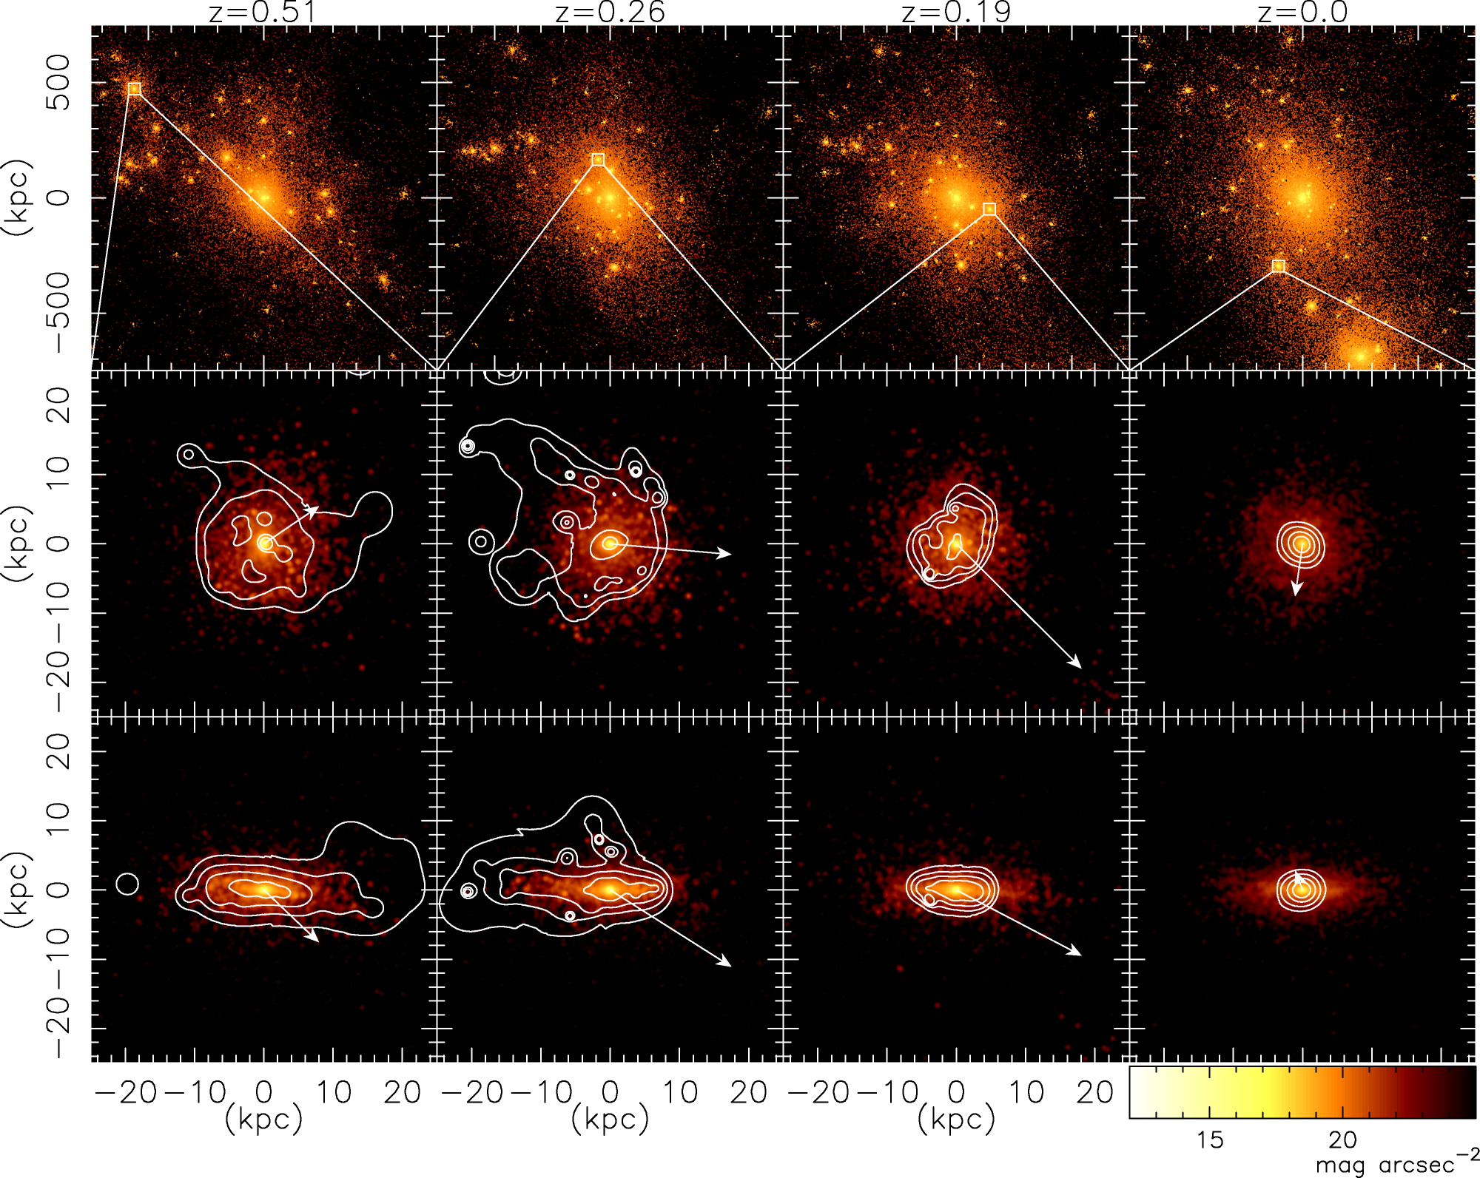
X-ray groups are rich environments where many of the processes not usually associated with groups can occur.
Simulation of an L* galaxy’s first passage through a typical X-ray group:
Most of the cold and hot gas stripped on first passage through group (less than a Gyr).
Kawata & Mulchaey (2009)

Slide 4
Direct evidence of stripping in many X-ray groups
50 kpc X-ray tail from an S0 galaxy falling in to NGC 6269 group.
Jeltema, Binder & Mulchaey (2009)

Slide 5
Are the X-ray “blobs” at the outskirts of Abell 133 associated with galaxy groups?
Use IMACS to measure redshifts for galaxies near the blobs
Obtained 3 masks in September/October, 2011
Used the 300 l/mm grism to cover 4000-10000 Å
Targeted 345 objects; measured redshifts for 259 galaxies
Measure redshifts for galaxies around 6 “blobs”

Slide 6
Infalling group

Slide 7
Infalling group

Slide 8
Infalling group? or background system (z=0.29)?

Slide 9
Background system (z=0.23)

Slide 10
Background system (z=0.12)?

Slide 11
Background system – redshift unclear

Slide 12
Summary
We have measured redshifts for 6 of the X-ray “blobs” at the outskirts of Abell 133
The redshift measurements are consistent with 2 (maybe 3) of the blobs being infalling X-ray groups
These observations suggest that a significant fraction of galaxies in clusters are pre-processed in X-ray groups prior to falling into the cluster.

