Slide 1
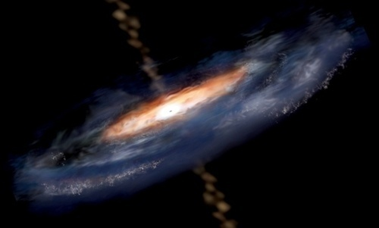
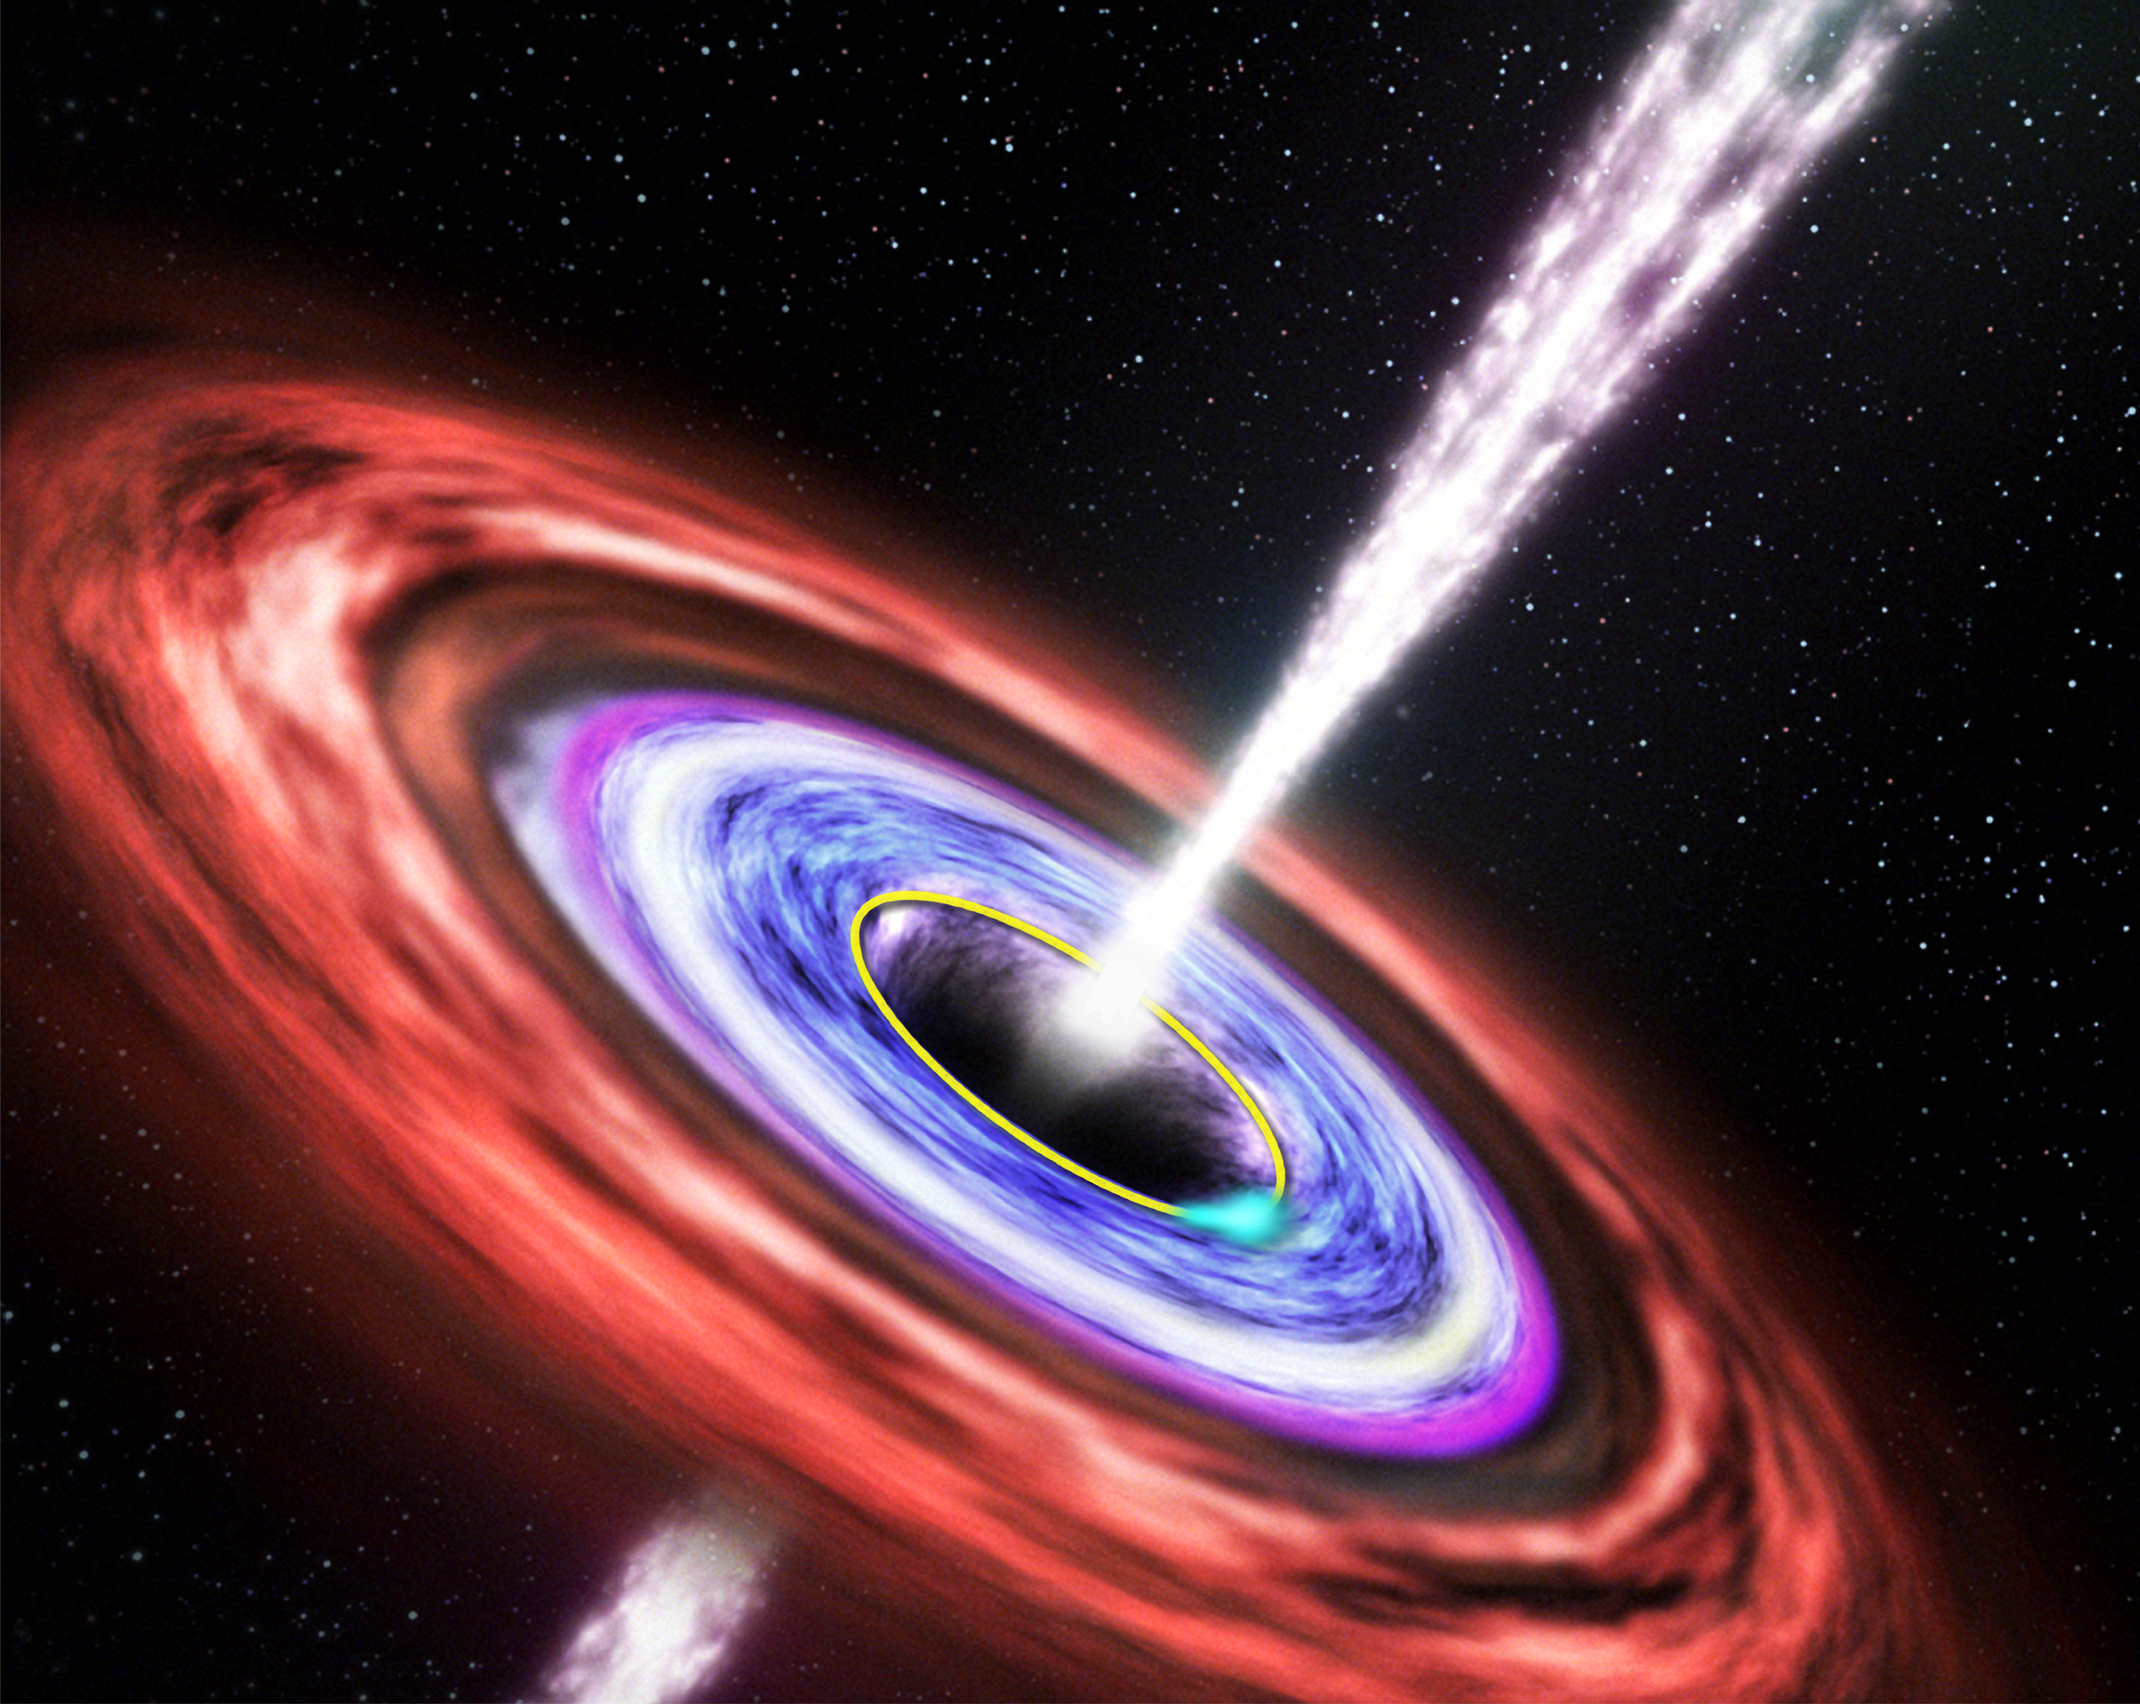
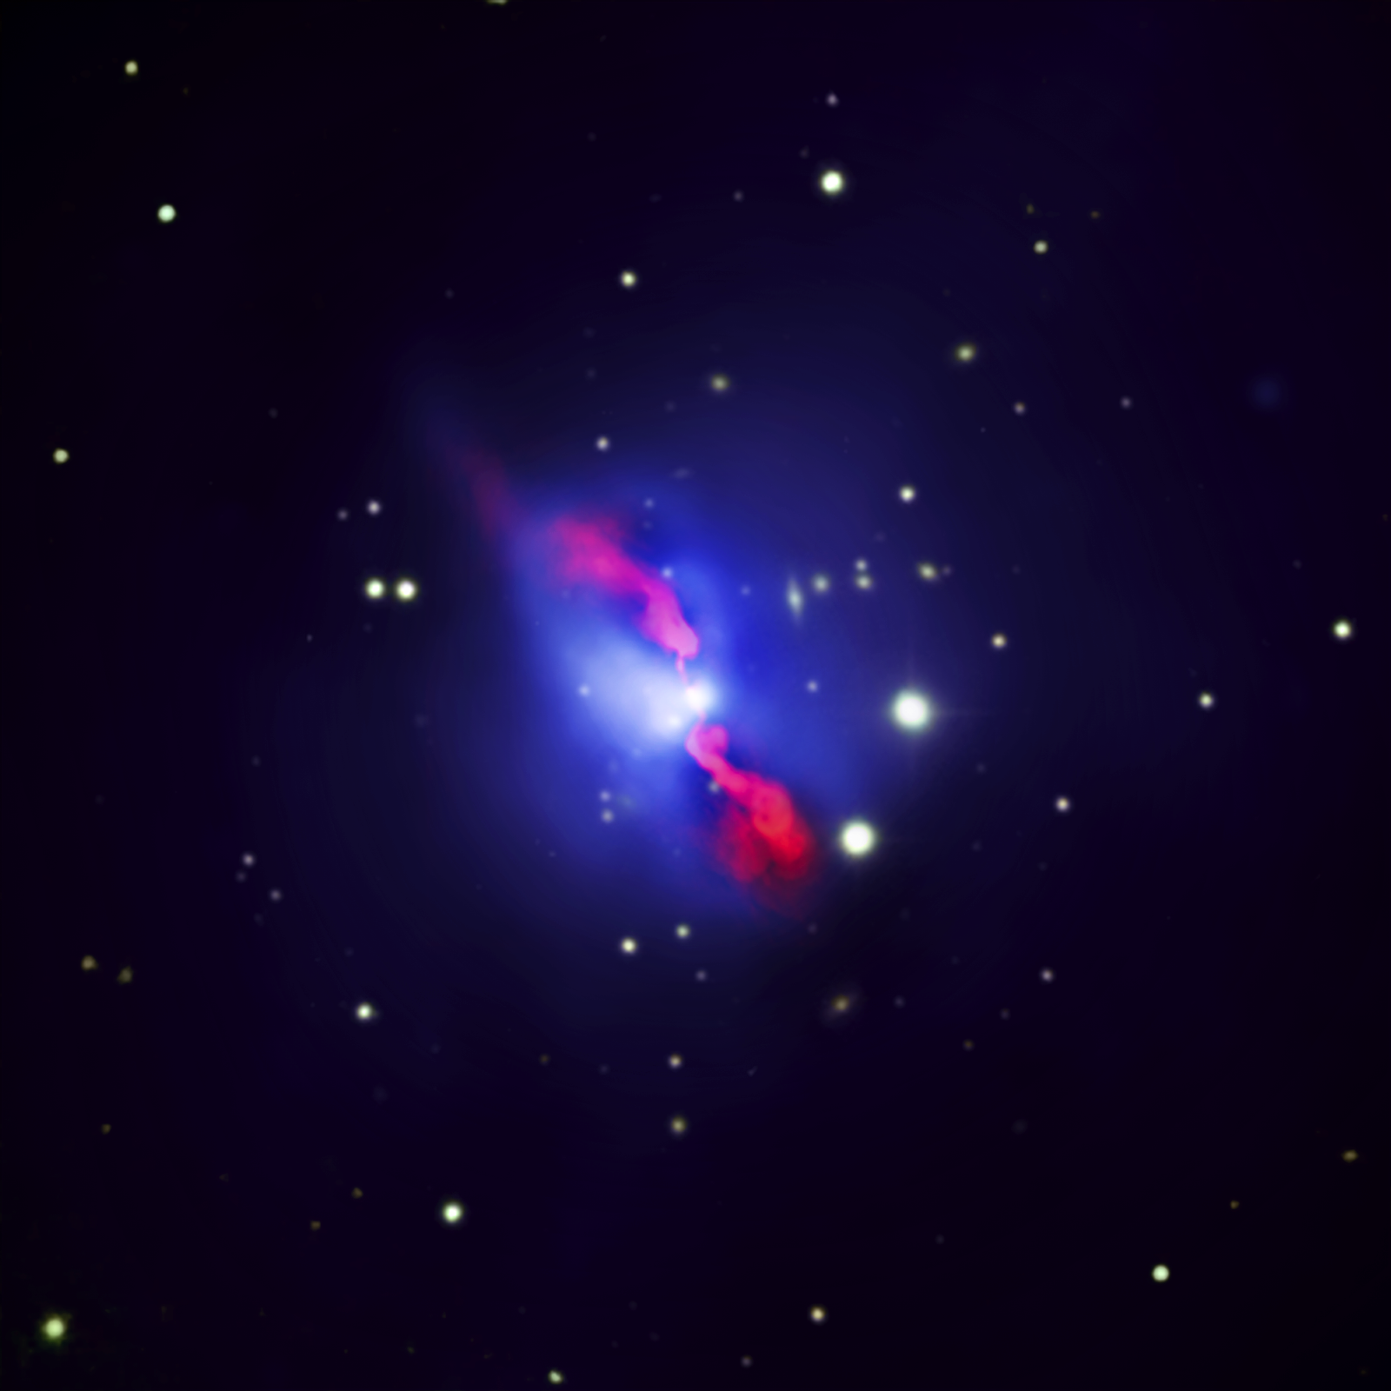
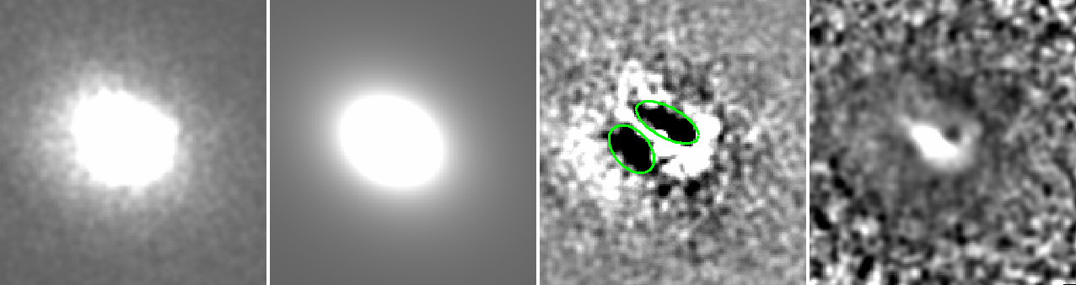


A systematic search for X-ray cavities in galaxy clusters, groups, and elliptical galaxies
Jaejin Shin^{1,2}, Jong-Hak Woo^{1,2}, John S. Mulchaey²
¹ Seoul National University, Seoul, Republic of Korea
² Carnegie Observatories, Pasadena, CA, United States
[O III] λ5007
Abstract
Results
AGN feedback is considered one of the most important phenomena for solving the "cooling flow" problem and driving the galaxy-SMBH co-evolution. As some of the strongest evidence for AGN feedback, X-ray cavities are useful for investigating AGN feedback over 10 kpc scales. Furthermore, X-ray cavities are believed to be connected with radio outbursts from AGN. By collecting all available X-ray data from the Chandra archive, we build up a sample of ~200 targets, including galaxy clusters, galaxy groups, and elliptical galaxies, in order to conduct a comprehensive study of X-ray cavities in various environments. Using modeling and unsharp masking techniques, we investigate the presence of X-ray cavities and their physical properties (i.e., cavity size) for the 89 targets with enough X-ray photons to perform the analysis. Here, we present our first results on the X-ray cavity properties and discuss environmental effects.
Cavity detection
Through beta modeling and the unsharp masking method, we detected 124 cavities from 49 (56%) targets of our 87 targets. The other 38 targets show little evidence of cavities or cold fronts. Since the gas distribution of targets showing cold fronts are asymmetric (Fig 3), we did not consider these features as cavities.
Abell 1991
Larger distance, larger cavity size
Figure 3. Fitting result of Abell 1991. Smoothed raw image (left), smoothed beta model subtracted image (center), and unsharp masked image (right). Green ellipse represents fake cavity.
Introduction
Cavity properties (Major axis a, Minor axis b, distance between x-ray center and cavity center, and area of cavity) are strongly correlated. The minor axis-major axis relation and distance-major relation are similar to previous results (Birzan et al. 2004, Dong et al. 2010).
The result of AGN feedback, x-ray cavities cover the larger scales (up to ~100kpc) compared to other feedback phenomena (i.e., AGN outflow).
Showing morphological links with radio emission, X-ray cavities likely originate from radio jets.
Studying x-ray cavities can provide clues into galaxy-SMBH co-evolution.
However, previous study focused on narrow dynamical range with small sample.
Here, we investigate x-ray cavities in a statistically large sample with a large dynamical range.
Log major axis b (kpc)
Log major axis b (kpc)
Log Area (kpc^2)
Figure.1 The composite image of Hydra A cluster. X-ray data from Chandra (blue), Radio data from VLA (pink), and optical data (yellow) from CFHT. This composite image is taken from chandra.harvard.edu.
Log minor axis b (kpc)
Log Distance D (kpc)
Log Distance D (kpc)
Figure 4. Comparison between cavity properties. Major axis a- minor axis b relation (left), Major axis a-distance relation (center), and Area of cavity- distance relation (right). Color represents temperature. Dashed line (Birzan et al. 2004) and dotted line (Dong et al. 2010) show previous results.
Sample
Higher temperature systems show larger cavities
The largest sample size with the broadest dynamical range
Log gas temperature (kev)
Spatial resolution limit
To study x-ray cavity statistically, we retrieved archival data from the Chandra archive. We obtained our initial sample from the Cluster of galaxies (1522), Normal galaxies (978), and Active galaxies and Quasars (2452) categories. By visual inspection, we excluded targets which are point sources, have low S/N data, or show merging features, and finalized 87 targets (Cluster of galaxies :78, Normal galaxies: 8, and Active galaxies and Quasars :1).
Our sample is the largest (87) to date for studying cavities and covers the large mass range from individual galaxies to galaxy clusters.
1. High temperature systems tend to be observed at higher redshift (Fig 5a). Due to spatial resolution limitations, we can not detect small cavities at high redshift (Fig 5b).
2. Lower temperature systems have smaller x-ray gas distributions. Therefore, we cannot observe large cavities in low temperature systems.
Log gas temperature (kev)
Log Redshift (z)
Figure 5a. Comparisons between redshift and gas temperature.
Log Area (kpc^2)
Growth limit
Log Area (kpc^2)
Log Redshift (z)
Figure 5. Comparisons between area of cavity and gas temperature.
Analysis
Figure 5b. Comparisons between redshift and area of cavity. Solid curve represents 1’’ circle area size as a function of redshift.
Beta modeling and Unsharp masking
Summary
We detected cavities using beta modeling and unsharp masking method in CIAO. Mainly we used the beta model subtracted image to detect cavities and obtained a hint from unsharp masked image. For 16 targets, we measure cavity properties from the raw image because the model fits were not good. Cavity size and distance from x-ray center were determined by visual inspection.
Out of ~5000 archival observations, we constructed a large sample of 87 targets with broad dynamical range and good S/N.
We detected 124 cavities from 49 targets using raw images or beta model subtracted images.
We found that the cavity size is larger when the cavity is farther from the x-ray center.
The observed temperature-cavity properties relation is due to the observational limit and intrinsic size of the X-ray emission.
RXJ1532.9+3021
Future plan
Investigating systematic difference between cavity detected targets and non-detected targets
Studying multi-cavities system
Comparing radio properties to cavity properties
Figure 2. Beta modeling and Unsharp masking results. Smoothed raw image (left), beta model (left center), residual image (right center), unsharp masking (right). Cavities are shown as green ellipses.
Measuring gas temperature
References
To investigate environment effects on x-ray cavity, we determined the gas temperature within R₂₅₀₀. R₂₅₀₀ was calculated using the temperature-radius relation (Eq. 12 of Virklihnin et al. 2006)
Birzan et al. 2004, ApJ, 607, 800 Dong et al. 2010, ApJ, 712, 883
C. C. Kirkpatrick et al. 2009, ApJ, 709, L69 Virklihnin et al. 2006, ApJ, 640, 691
Equation 1. temperature-radius relation
Contact : Jaejin Shin
jjshin@astro.snu.ac.kr

