Slide 1
The NRO-1 2.4-m Telescope:
A game-changing opportunity to accomplish priority science programs of “New Worlds New Horizons”
-- Alan Dressler
presentation at the WFIRST Meeting-in-a-Meeting at the AAS in Anchorage, Alaska
June 12, 2012

Slide 2
Following a productive meeting in Pasadena, CA on June 13-16, 2012 at which we reviewed progress on the WFIRST mission --- highest priority for space science of the 2010 New Worlds New Horizons Decadal Survey in Astronomy & Astrophysics, we assemble in Anchorage to review some of the science discussed in Pasadena and progress on WFIRST designs and reference missions by the Science Definition Team.
A new development since Pasadena:
NASA hopes to use the first of the NRO telescopes --- 2.4m f/8 Cassegrain telescopes that are space --- to further the scientific goals of the New Worlds, New Horizons Decadal Survey. NASA HQ has used preliminary work at JPL and GSFC to establish that these telescopes are suitable for astronomical observations and, in particular, that a wide-field near-IR telescope is a possible adaptation of one of these (essentially) finished telescopes.
My presentation here at the AAS follows one I made at the inaugural meeting of the CAA on June 4. It is based on the work of a small group asked by NASA HQ to provide a preliminary answer to the question “Can a 2.4-m NRO-developed telescope make substantial progress on the priority science goals of the NWNH survey?” This group included Matt Mountain, David Spergel, Marc Postman, Jeremy Kasdin, Erin Elliott, and Alan Dressler.

Slide 3
The New Worlds New Horizons Decadal Survey recommended 1.5-m wide-field infrared space telescope --- WFIRST --- as its highest priority space mission for the 2010-2020 time frame. The recommendation to the Decadal Survey Committee from the Electromagnetic Observations from Space Panel was based on the recognition that, among the >50 proposals for new space initiatives, several of the highest priority science programs needed essentially the same space facility:
“Subjects as disparate as the history of the acceleration of universe, the discovery of exoplanets in habitable zones and beyond, the history of the assembly of the Milky Way and the evolution of galaxies in the first billion years all stood to benefit from the dramatic increase in the number of infra-red sensitive pixels -- roughly 200 million -- that one could reasonably hope to place in orbit.” --- Dr. Paul Schechter, testimony to the House Appropriations Subcommittee, March 22, 2012
Schechter’s point is key: The NWNH vision of the WFIRST mission was a 1.5-m telescope with a large-area IR camera. Although the description of WFIRST in NWNH included a strawman concept for the telescope (essentially the JDEM-Omega design), it is not the telescope that defines WFIRST, but neither is WFIRST just a collection of science goals. The hardware that is the key is a wide-field IR camera in space, capable of carrying out a diverse program of Dark Energy, Planet-finding, Surveys, and GO science.

Slide 4
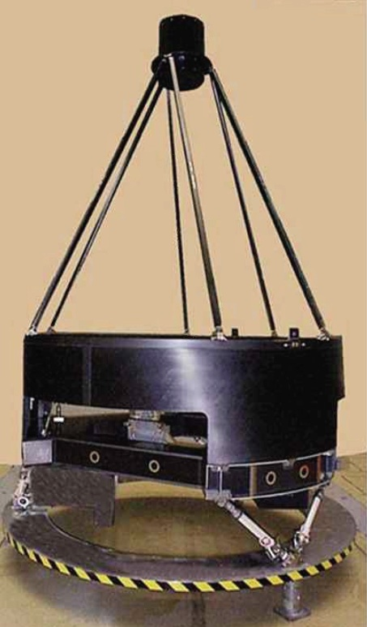
Brief Summary of New Asset
Picture of the “dynamic test unit”courtesy of Exelis via Gary Matthews
Two 2.4-m telescopes have been transferred to NASA:
  Designed as a TMA system but tertiary mirror is not applicable for science mission
  Primary mirror is f/1.2, on-axis system
  Compact design is similar to the dynamic test unit shown here
  Thermal control heaters are already on the shell
  6 struts position the secondary mirror
    6 actuators at the base of the SM struts
    1 focus actuator on the SMA for fine focus
  Long struts to spacecraft bus provide approximately 1.5m of available space for aft optics, instruments, etc.

Slide 5
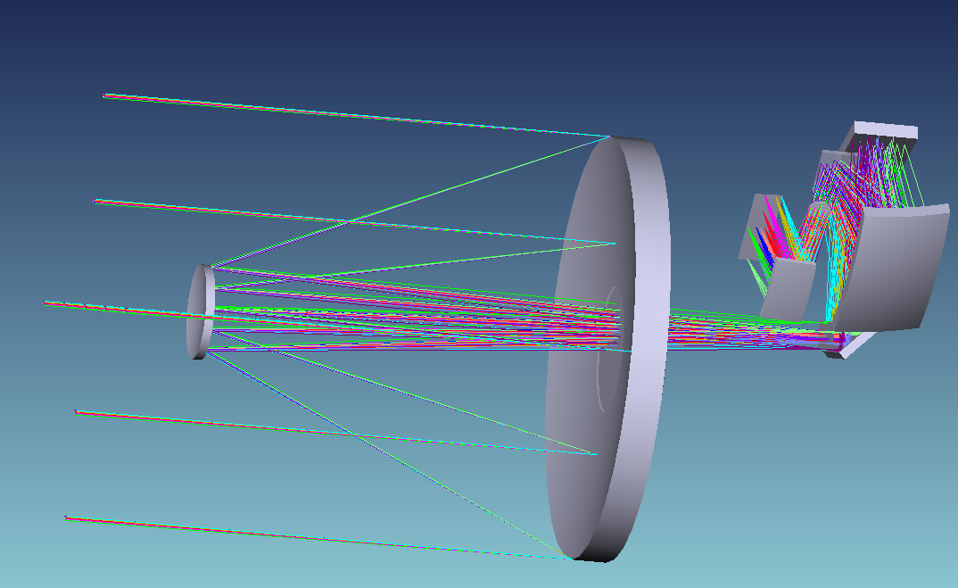
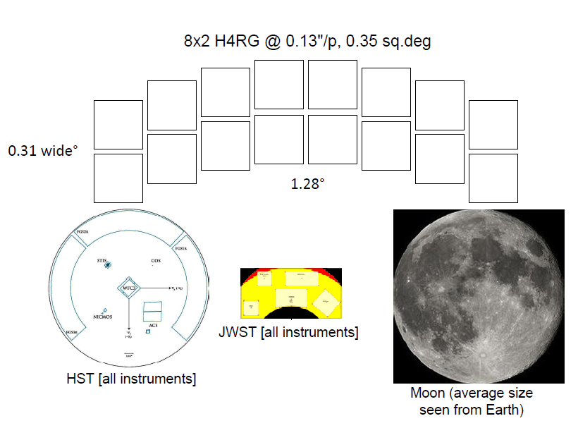
Potential Payload Overview:
- 2 wide field instruments - 2 small, finer sampled instruments
Preliminary Instrument Design:
Based on existing telescope primary and secondary mirrors without changes
Initial wide-field instrument shown; 2nd wide-field instrument would be a mirror image
  3 mirror camera, folded, with filter at pupil
Filter & prism wheels (not shown) in ea. wide field instrument
Fits within instrument volume
implied by existing struts
GSFC study
Filter
C2
F2
FPA
C3
C1
F1

Slide 6
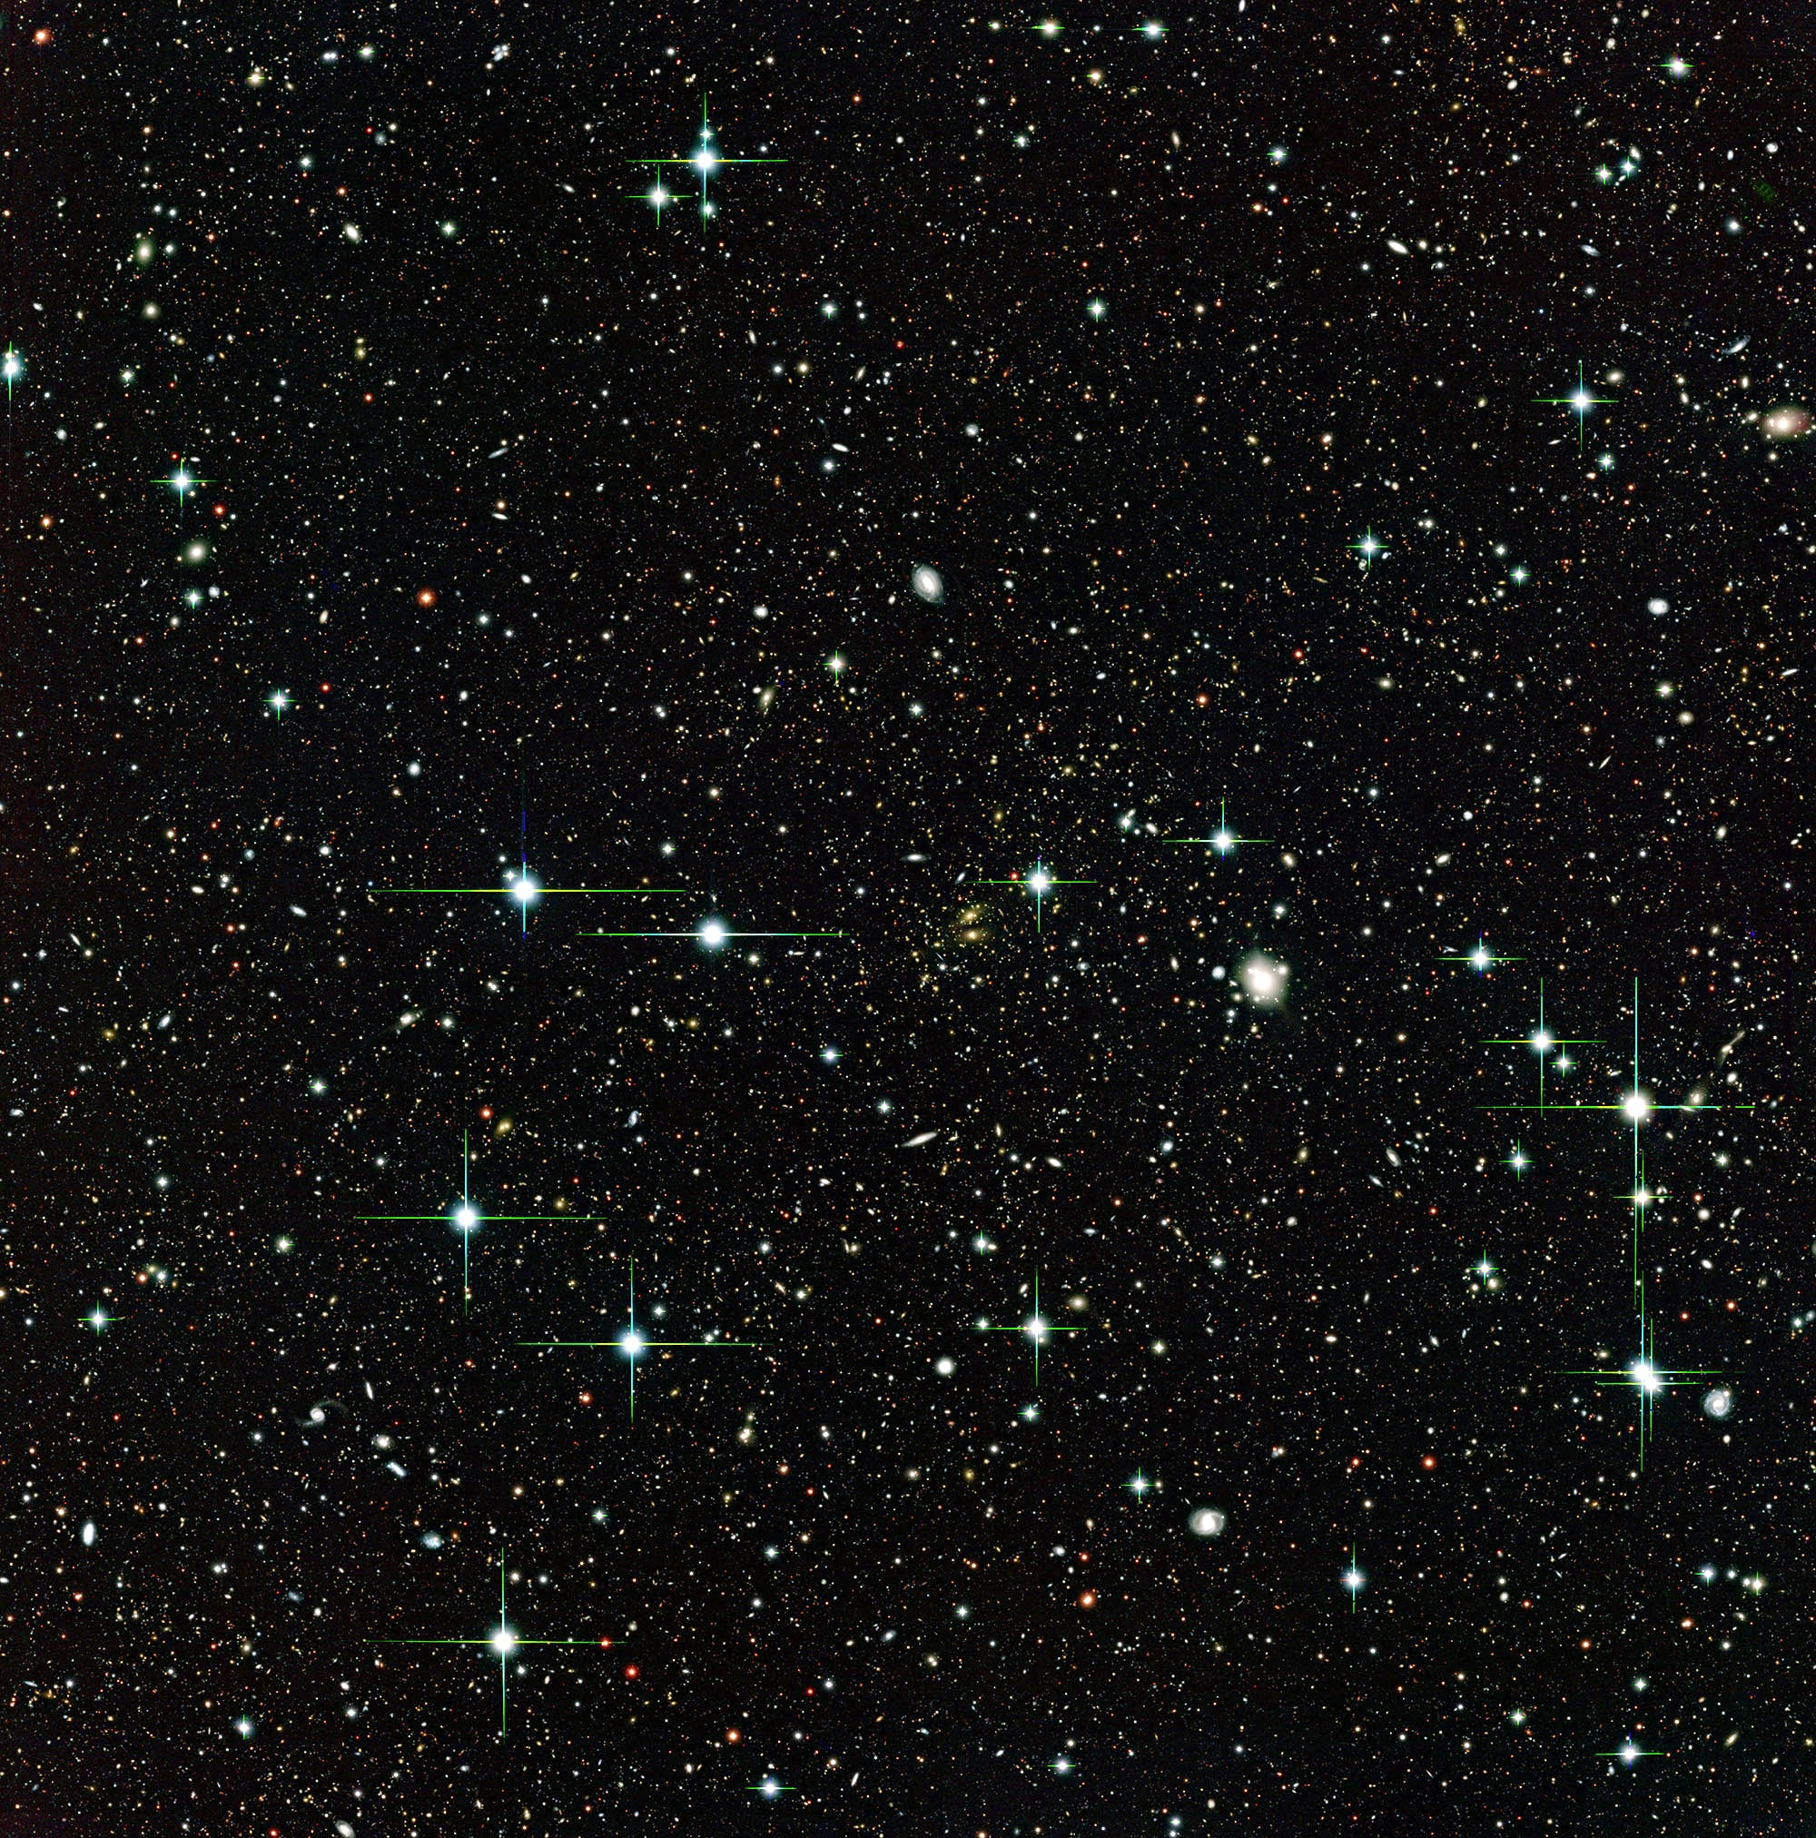
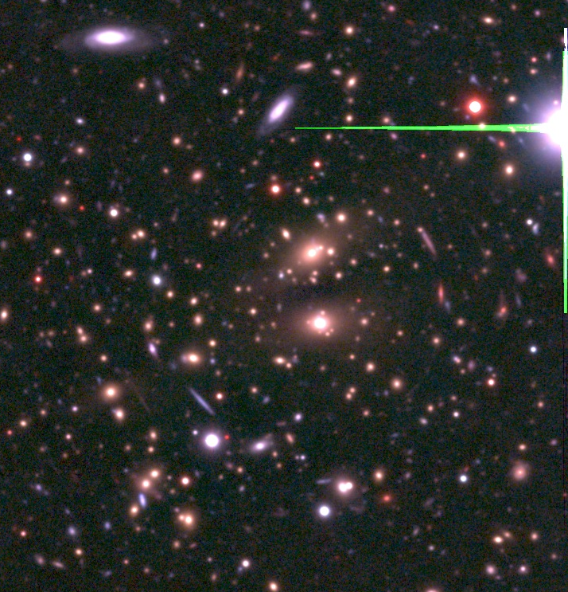
100x the Area as HST’s WFC3/IR cam
HST WFC3/IR FOV
Existing telescope has a 2.4-m
f/1.2 primary with a 9% obscuration secondary that produces a 1/20 wave near-IR optical system at about f/8 assembled and tested.
A preliminary 3-mirror design could use 16 Hawaii 4RG HgCdTe IR- detectors (10μm pixels) to cover 0.25 sq deg at 0.11”/pixel, compared to this telescope’s 0.15” diffraction limit at 1.5μm
This is slightly better sampling than the SDT 1.5-m WFIRST with 0.18” pixels for a 0.24” diffraction limit.
0.25 sq deg FOV

Slide 7
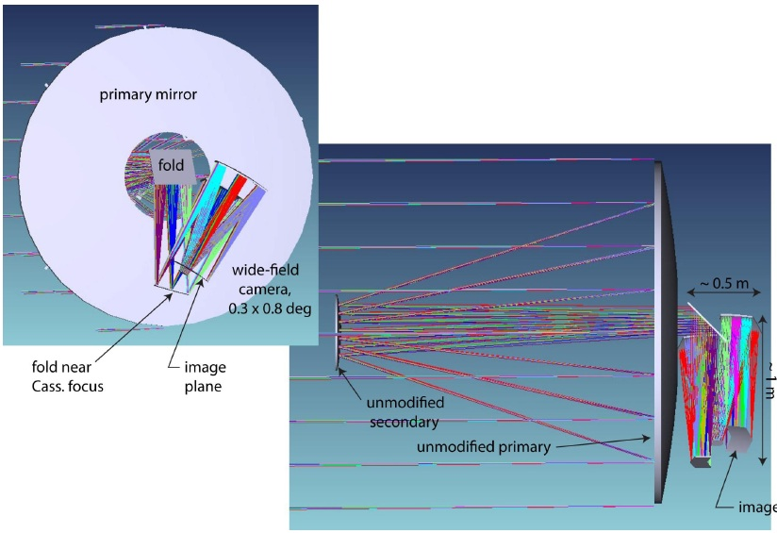
Placed after the existing (unaltered) telescope design
FOV – 0.3° x 0.8° = 0.24 sq deg
Diffraction limited at 700 nm
EFL = 25.656 m, F10.7
10 μm pixel ≈ 0.08 arcsec
24 4Kx4K H4RG detectors needed
Fits in a volume of 0.5-m x 0.5-m x 1.0-m (not including mounts and electronics)
Room for a second wide-field camera of same size (could also further widen field of this design)
Accessible pupil for filters
Most recent NRO-1 camera design from Erin Elliott (STScI)

Slide 8
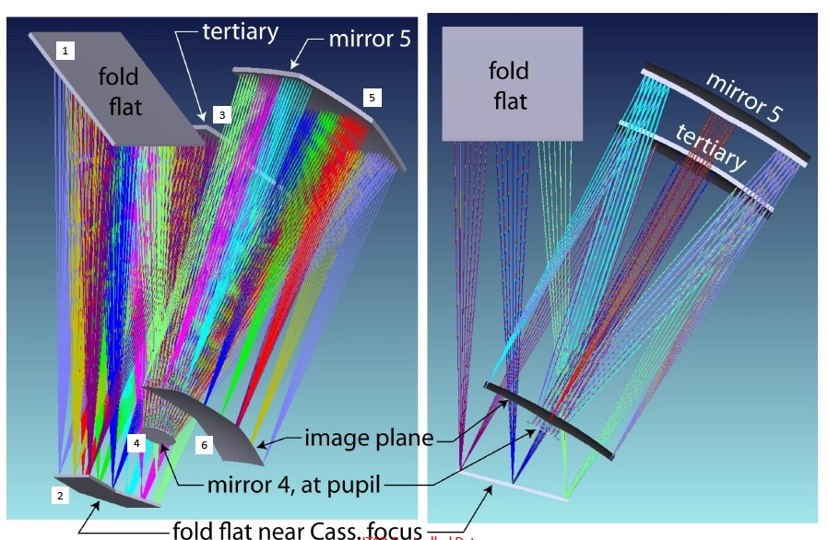
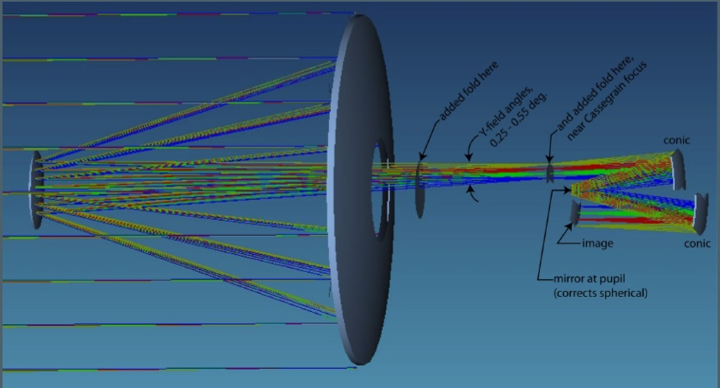
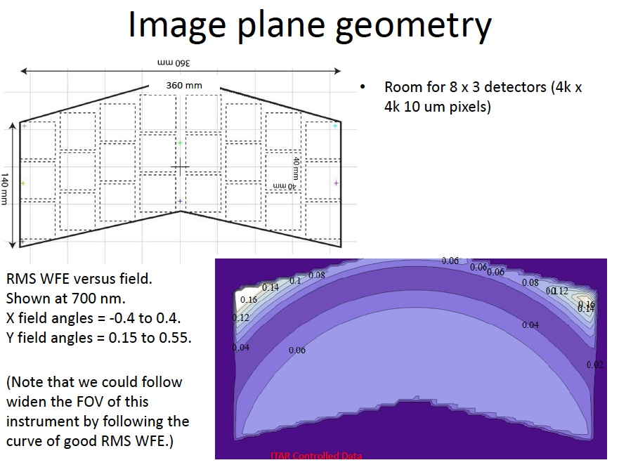
unfolded
Chevron shape will not tile well, and psf variations at the top edge are unacceptable for weak-lensing program.

Slide 9
A preliminary look at how the NRO-1 telescope will accomplish the two “core program” goals, Dark Energy surveys and Microlensing planet-finding:
DARK ENERGY
Supernovae: A 2.4-m telescope with a camera covering 0.25 sq deg and sampling comparable to the prior WFIRST designs will outperform the smaller telescopes, because of the smaller psf (factor of 1.8 compared to DRM2). With an area as large as 0.50 sq deg the SN survey will be substantially better, reaching 1 mag deeper of the same area (higher redshift) or substantially more area at the same depth as DRM2.

Slide 10
Extragalactic Survey Programs – Imaging (Weak Lensing) and Redshift (BAO) surveys -- with the 2.4-m NRO-1 telescope --- Chris Hirata (Caltech)
          Assumptions:
2.4-m, obstructed, with mask at real exit pupil
H4RG detectors @ 0.0975”/p (1 pix = 10 μm)
  Same sampling relative to the diffraction spot as WFIRST-DRM1.
  Assumed that a read noise of 20 e/CDS (with 5 e floor) reached for the mature devices.
Area = 0.25 deg² --- this is 20 detectors.
Fore optics @ 250 K
4 filters for survey mode (F105/F129/F159/F194), similar to 2012 WFIRST DRM.
  But with λ_{max} = 2.175 μm (where it gets painful).
  Compare to red cutoff of 2.0 μm (WFIRST 2011 IDRM) or 2.4 μm (current WFIRST).
Copied the WFIRST DRM1 observing sequence, but with longer exposures for the imaging mode (270 s) to get below the read noise at the lower frame rate.
This is only a preliminary sensitivity calculation – would need a serious study to understand the issues involved.

Slide 11
Summary: Extragalactic Surveys
Chris Hirata: (cont.)
Increasing complementarity with EUCLID
 | WFIRST DRM1 | WFIRST DRM2 | Big Telescope
Implementation | 1.3 m unobs 36 H2RG 0.18”/p | 1.1 m unobs 14 H4RG 0.18”/p | 2.4 m obs 20 H4RG 0.0975”/p
Imaging Survey* [4 filters for all; depths are 5σ isolated pt src] | 0.92—2.40 μm 26.0—26.2 mag AB 2800 deg²/yr EE50 = 0.15—0.21” | 0.92—2.40 μm 25.8—26.0 mag AB 2900 deg²/yr EE50 = 0.18—0.25” | 0.92—2.17 μm 26.9—27.3 mag AB 1080 deg²/yr EE50 = 0.11—0.14”
Weak Lensing [reddest 3 filters] | 30, 33, 32 gal/am² | 24, 26, 25 gal/am² | 79, 82, 72 gal/am²
Redshift Survey [≥7σ Hα detections] | z = 1.28—2.66 4900 gal/deg² 2900 deg²/yr | z = 1.59—2.66 2900 gal/deg2 4400 deg²/yr | z = 1.13 – 2.20 4900 gal/deg² 4000 deg²/yr
* The big telescope could in principle support an accelerated imaging mode matching the WFIRST DRM1 survey rate of 2800 deg²/yr. This reaches depth of 25.8—26.0 mag AB and 26/31/32 galaxies per arcmin². This survey is heavily read noise limited (90 s exposures) so may not be the best use of a big telescope.

Slide 12
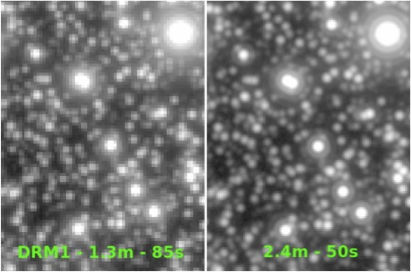
Microlensing Planet Finding
From Matthew Penny (OSU) and David Bennet (NDU): Microlensing planet-finding: a demographic survey complementing Kepler mission, R > 1AU – beyond the snow line!
Performance of NRO-1 2.4-m compared to SDT WFIRST (DRM1) . The images compare an “equal-duration, equal-area” survey of a Galactic Bulge field (assuming a 2.4-m field of 0.25 sq deg). The total area covered in 15-minute cycles is 2.5-deg, with 7 DRM1 fields or 10 2.4-m fields.
16”

Slide 13
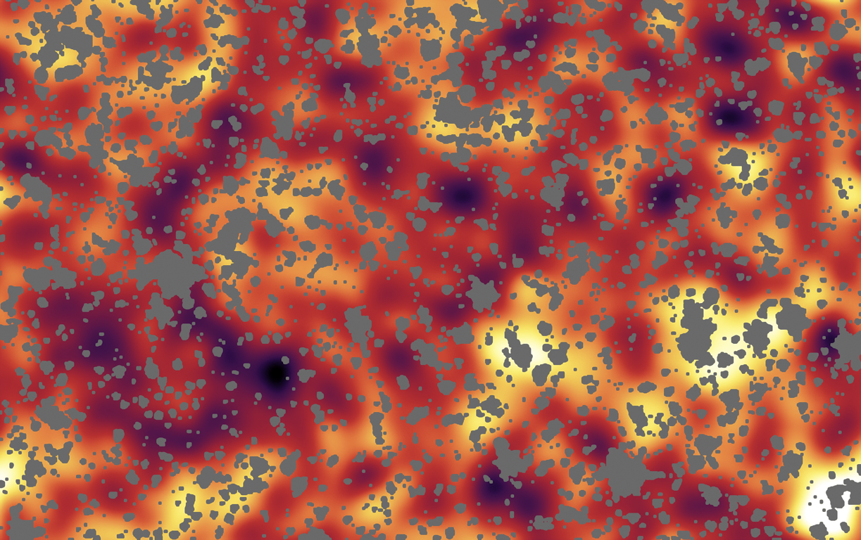
Other powerful wide-field IR survey science:
From Daniel Stern’s talk at “Science with a Wide-Field IR Space Telescope” (http://www.ipac.caltech.edu/wfir2012)
diffuse infrared background in the near-IR is a probe of primordial star formation at z > 8. WFIRST or NRO-1 2.4-m trumps JWST because of the more than an order-of-magnitude greater entendue
clustered emission from first generation of star formation in the Universe;
expected at near-infrared wavelengths (controversial claims already by Spitzer)

Slide 14
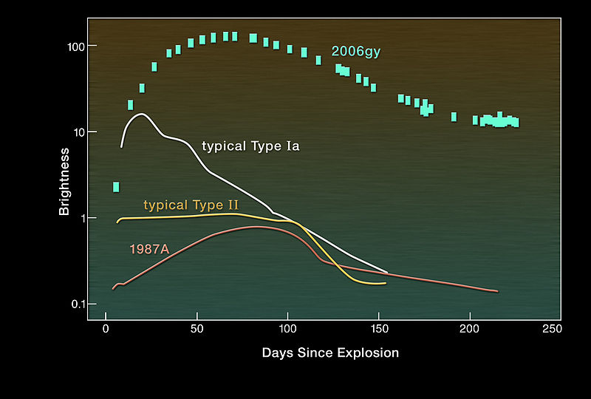
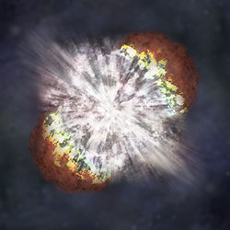
From Daniel Stern’s talk at “Science with a Wide-Field IR Space Telescope”
population III supernovae (see Ranga-Ram Chary’s talk): Could be hard to find with JWST – greater entendue of NRO-1 could make the difference.

Slide 15
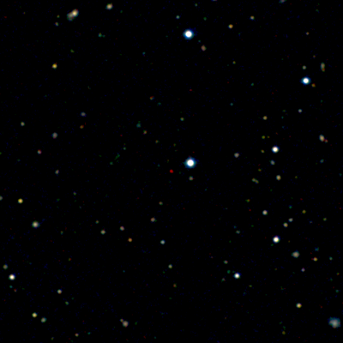
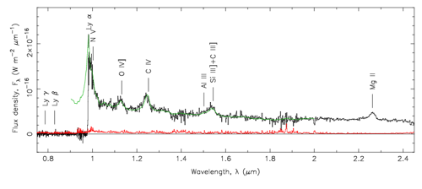
From Daniel Stern’s talk at “Science with a Wide-Field IR Space Telescope”
Large samples of quasars 6 < z <10 !
WFIRST will revolutionize studies of cosmic dawn
  measure the first epoch of black hole formation in the universe
  probe earliest phases of structure formation
  unique probes of the intergalactic medium -- the epoch(s) of reionization
  WFIRST will identify the rarest, most distant luminous quasars – NOT JWST science!
QSO at z=7.085. [From Mortlock et al. (2011; Nature, 474, 616).]

Slide 16
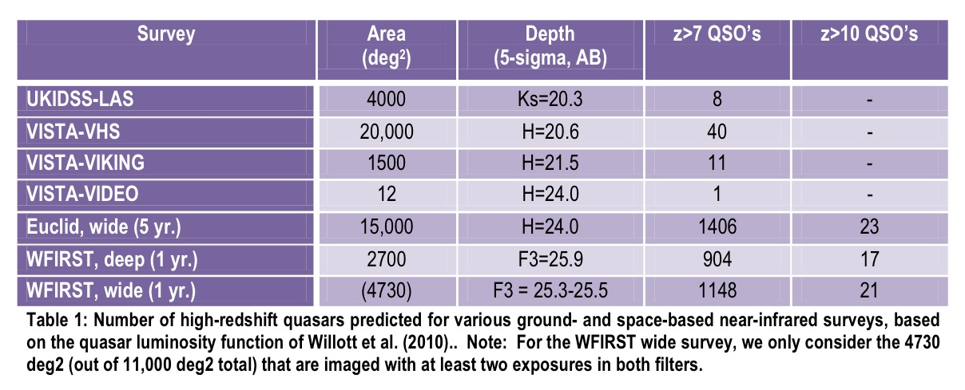

From Daniel Stern’s talk at “Science with a Wide-Field IR Space Telescope”
high-redshift quasars --- these numbers for WFIRST,would be much improved with NRO-1
WFIRST will revolutionize studies of cosmic dawn
  surveys to date have identified 15 quasars at z ≥ 6, including 1 at z ≥ 7
  ambitious current surveys (e.g., UKIDSS, VISTA) expect to reach ~100 quasars at z ≥ 6 in next few years, including 1-2 at z ≥ 8
  WFIRST will identify 1000’s of quasars at z ≥ 6, and push out to z~10+
Green et al. 2011, WFIRST IDRM (arXiv:1108.1374)
LF

Slide 17
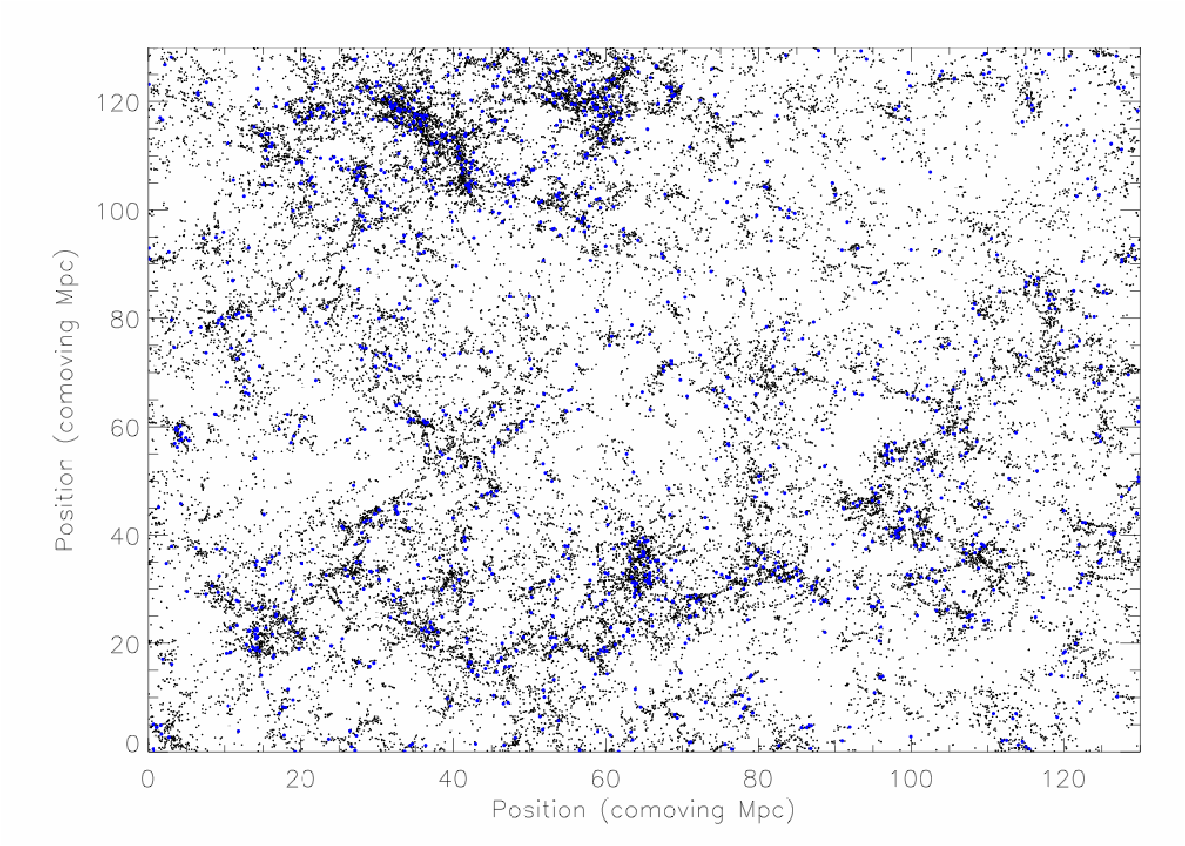

From Daniel Stern’s talk at “Science with a Wide-Field IR Space Telescope”
LBGs and LAEs to z~10
WFIRST will be an unprecedented probe of the z~7+ universe
  cosmic variance and issue for HST/JWST studies of LSS at z~7+
  expect large change in LAE LF at reionization; deep grism survey should be sensitive to LAE’s during the epoch(s) of reionization; map reionization
  brightest LBGs amenable to detailed study: UV slopes, HeII 1640 emission, early IMF
JWST or Hubble
Fantastic source catalog for JWST spectroscopy!
Simulated large scale structure at z=6.6. Black dots are collapsed haloes, blue dots are LAEs. The cyan box in the upper right corner shows the field of view of Hubble/ACS, illustrating that Hubble (and JWST) has much too small of a field of view to study the spatial distribution of z~7+ galaxies. [From Tivli et al. 2008.]

Slide 18
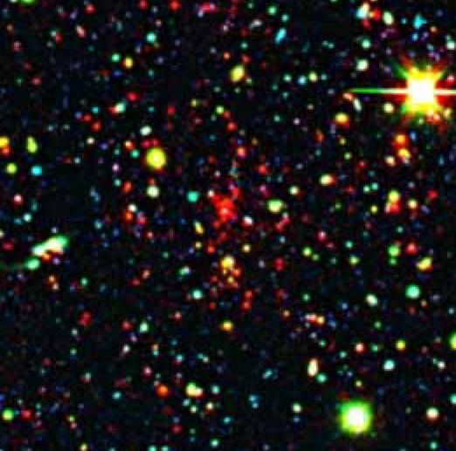
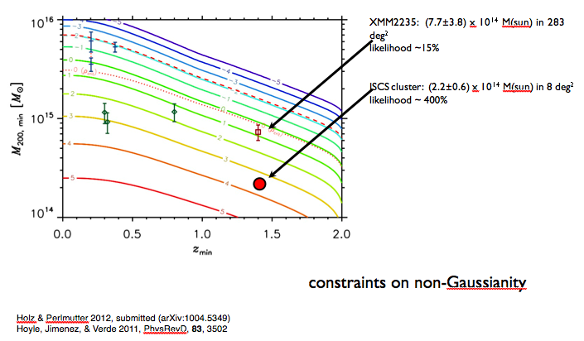
From Daniel Stern’s talk at “Science with a Wide-Field IR Space Telescope”
galaxy clusters at z>1
WFIRST will be an extremely powerful tool for finding and confirming clusters at z>1
  interesting cosmologically, for growth of structure
  interesting cosmologically, for probing non-Gaussianity (“pink elephants”)
  interesting cosmologically, for efficient identification of type Ia supernovae
  interesting for galaxy evolution
  synergy with eROSITA and SZ surveys
IR-selected galaxy cluster at z=1.413. From Brodwin, Stern et al. (2011; ApJ, 732, 33).

Slide 19
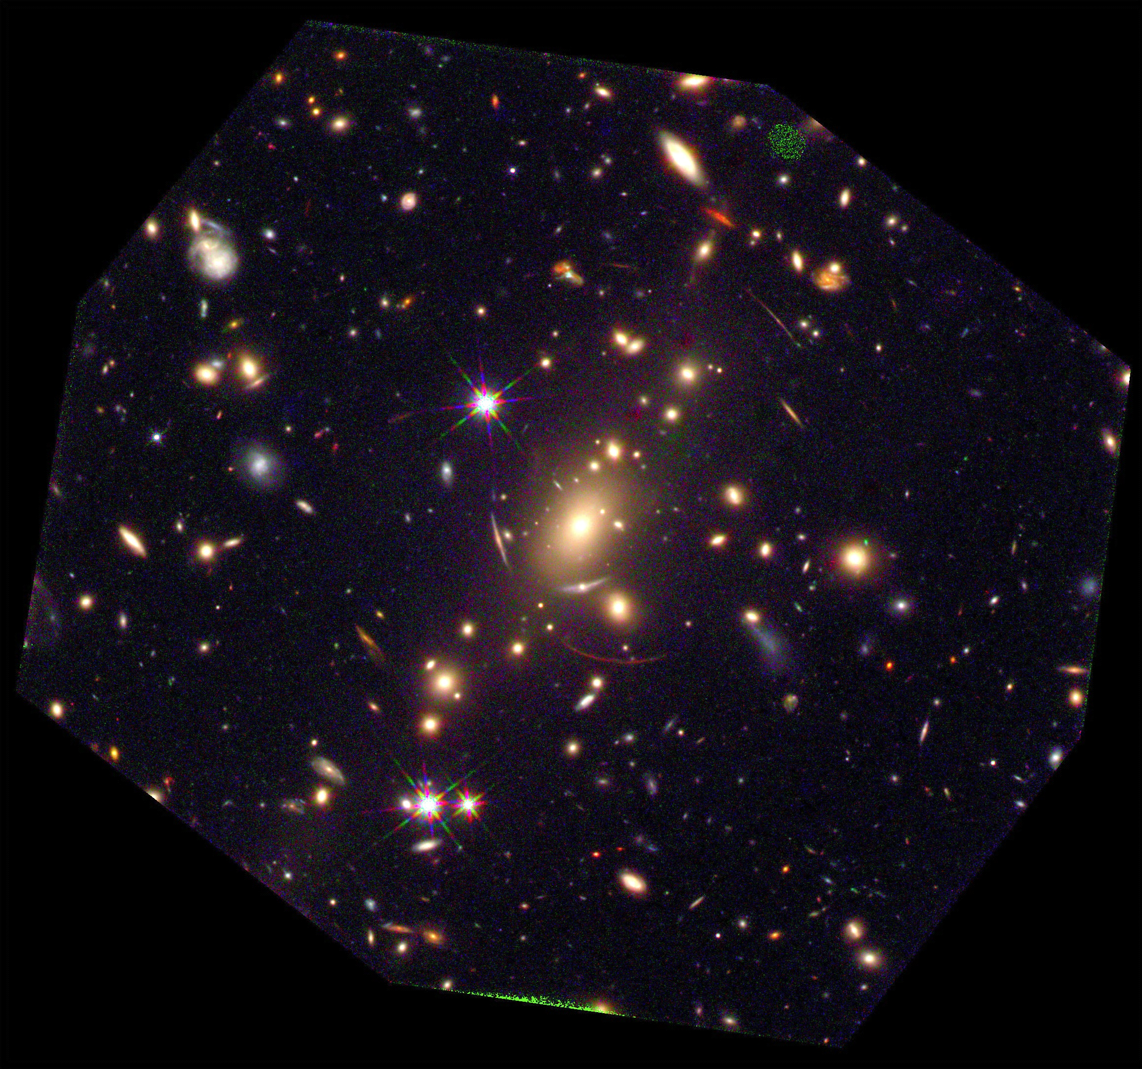
From Marc Postman: HST+WFC3 image of one of the CLASH clusters – 1-2 orbits/color
MACS1115
B=F105W
G=F125W
R=F160W
Carry-out detailed studies of galaxies in cluster-infall regions (R ≈ 5 Mpc (0.25-deg) impossible with HST, JWST

Slide 20
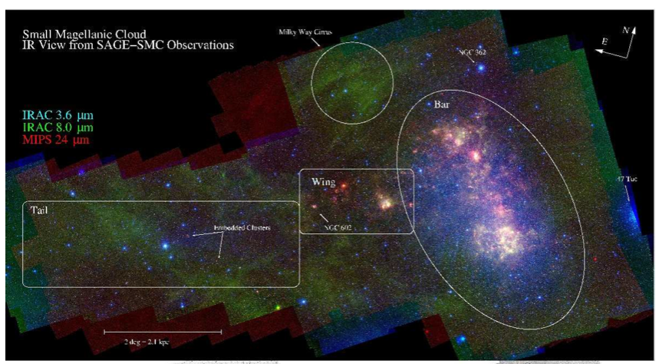
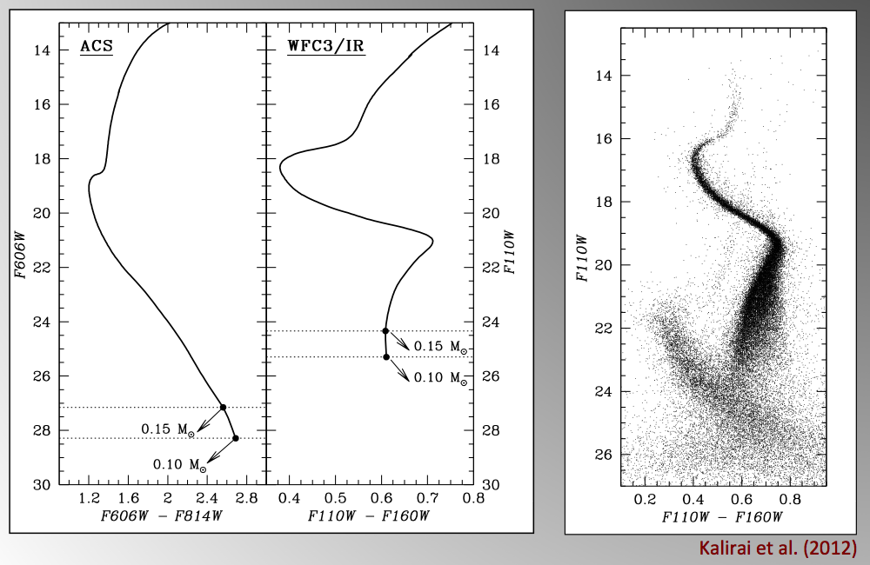
Jason Kalirai (coming up) will cover resolved stellar populations in nearby galaxies
IR color map of SMC is rich in structure that can be identified as distinct stellar populations with color-magnitude diagrams that include near-IR colors (from D. Stern talk)
J. Kalirai: adding IR colors greatly improves precision of age, metal abundance measurements for old stellar populations

Slide 21
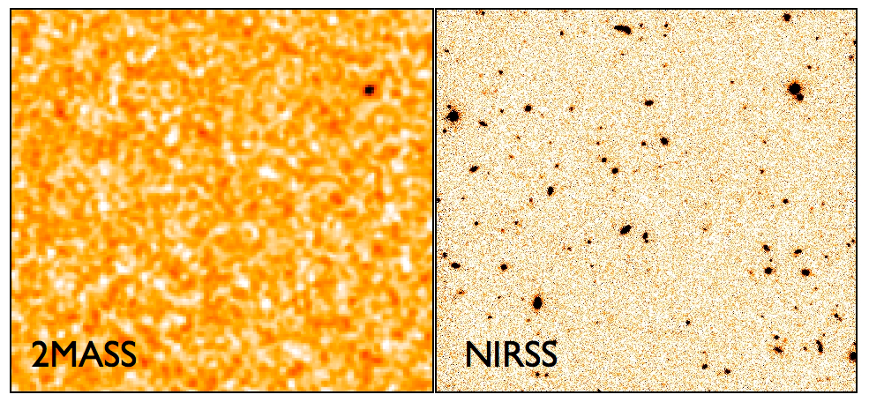
All these programs, and many more, will be possible because of the F < 0.1 μJy ( > 26 AB mag) reached by NRO-1 for wide-fields. This flux limit is, by the way, a perfect match to the LSST optical surveys: together, astronomers will have a broad photometric catalog that will be powerful for galaxy formation and evolution studies
2MASS
WFIRST

Slide 22
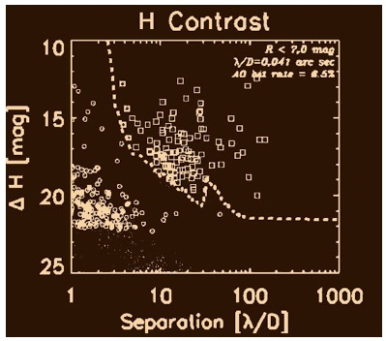
Jeremy Kasdin: Coronagraphy with the NRO-1 2.40-m Telescope
Recent advances allow high-contrast imaging at small angles with on-axis telescopes
Uncorrected contrast of up to 10⁻⁵, Corrected (with DM) to 10⁻⁸ or better
Corrected contrast limited by telescope stability
Another order of magnitude possible via post-processing
Inner working angles from 2.5-3 λ/D depending on contrast
Experimental verification of designs and approach in place
Gemini Planet Imager
Rich Scientific Opportunities
Jovian Planet Finder!
Exozodi characterization at inner solar system
Characterization of RV and Transiting planets
Protoplanetary disks, brown dwarfs, Hot Jupiters
Explores habitable zones around up to 30 nearby GFK stars and many more nearby M stars.
Technology pathfinder for future large telescopes
Complements ground systems (GPI, SPHERE, Subaru) – Observes in unexplored search space.
40 400 4,000 40,000
Separation [mas]
2.4-m NRO-1 Telescope
dots - all planets
circles - RV
squares - GPI
Image from GPI website (planetimager.org/pages/science_planets.html)

Slide 23
The NRO-1 2.4-m telescope: accomplishing the WFIRST science program of New Worlds New Horizons– and more (and better):
The 2.4-m telescope will better resolve distant galaxies and has the potential to measure their shapes to higher precision. This telescope can match or improve measurements of weak lensing and redshift surveys, and constrain the distribution of dark matter.
The 2.4-m telescope’s higher resolution will enable it to detect and characterize supernova at higher red-shift, strengthening the third leg of the Dark Energy program.
For planet-finding survey, the 2.4-m telescope will be more sensitive to micro-lensing events because of reduced confusion – more targets, and more accurate photometry.
The 2.4-m telescope’s will be a Hubble-like near-IR telescope, delivering 0.1-0.2 arcsec imaging at 0.1μJy for studies of the stellar populations of nearby galaxies, multi-color surveys of evolving galaxies 1<z<5, quasars up to z=10, large-scale structure at z=7, the growth of structure z < 4, surveys for and studies of cool stars, star formation in the Galactic plane, and on and on…
As well as carrying out its core program, and serving the broad astronomical community through deep and broad surveys and a diverse GO program, the 2.4-m wide-field infrared space telescope will support and complement JWST in its primary goals of the study of the early universe and the formation of stars and their planetary systems. NRO-1 and JWST will continue the tradition started at Palomar with the Schmidt and Hale Telescopes by providing the traditional wide-field “surveyor” for deep follow-up studies by JWST.
Combining the 2.4-m aperture with its superb on-axis image quality with advances in high-contrast imaging could be a huge step forward in exoplanet research: Jovian-planet finder; Exo-zodi mapper, and even explorer of the habitable zones of the nearest GFK stars searching for Earth-sized worlds.

Slide 24
Some of the issues that need further, detailed study
The Question: Can the science goals of NWNH be suitably mapped onto the existing NRO-1 2.4-m optical telescope assembly (OTA) being made available to NASA with a minimum of changes?
The issues include:
How to package a wide-field IR camera.
Area > 0.25 deg? Two cameras? Slightly better sampling?
The system temperature of the existing OTA, existing coating and long-wavelength cutoff – impact on science program?
L2 or Geo-sync orbit: does this enable a more cost-effective launch options and data transmission advantages?
What is the expected stability of optical system given the option to control alignment and more complex optical train compared to SDT WFIRST concept. Will active control compensate for a Geo-Sync orbit and how important is “knowledge” of PSF compared to the ability to control the PSF?

Slide 25
Some issues that need to further detailed study (cont.)
What spacecraft is required? Heritage design? Schedule and cost?
Possible “secondary” on-axis instrument, for example, small optical channel or coronagraph.
Is it possible to cap the cost to launch at < $1.6B, and launch before 2022?

Slide 27
MPF in Geosynchronous Orbit
Ω
Ecliptic
Sun
Plane
Equatorial
Plane
Orbit
Ω
23.5°
28.7°
Vernal
Orbit Plane
MPF field
Equinox
MPF’s orbit allows continuous view of Galactic bulge planet search field and continuous data data downlink to a dedicated ground station in White Sands.

Slide 28
My personal perspective:
Prior to the disclosure of this NRO opportunity, NASA’s WFIRST Science Definition Team, led by Paul Schechter and Jim Green, had made great progress in developing the WFIRST mission well beyond the original notions laid out by the EOS Panel and NWNH Decadal Survey Reports. Two design reference missions that could meet and exceed NWNH science goals, within time frame and budget, are well advanced.
However, In my opinion, if one of the “new opportunity” NRO 2.4-m telescopes can match or improve on performance, cost, and schedule for the full WFIRST science program --- DE, Exoplanets, IR Surveys, and GO --- this new opportunity supercedes and essentially replaces previous proposals for the WFIRST telescope, but not of course for the wide-field IR camera – the heart of the project. I personally cannot imagine shelving a 2.4-m telescope to pursue one of the current SDT designs unless it could be demonstrated the 2.4-m would fail qualitatively to accomplish the WFIRST science. In that case, NASA and the community would face a difficult decision about whether to go ahead with implementing some reduced WFIRST program, and/or something else covered in NWNH (but not the highest priority) but using NRO-1.
The present preliminary report suggests that this is not the case and that the potential exists to have greater capability for the WFIRST science, enable additional scientific opportunities, match or reduce cost, and improve schedule, and that this possibility should be pursued as vigorously as possible by the astronomical community.

