Slide 1
The Carnegie RR Lyrae Program and a 12-inch Telescope
Andy Monson
Instrumentation and Support Scientist
Proud supporter of:

Slide 2
POP-II Stars as parallel calibrators to Cepheids
Problem: The major source of uncertainty in H₀ is that ultimately, 10 Cepheids anchor the PL zeropoint and 8 galaxies pin Cepheids to Ia-SNe; this is a small statistical sample.

Slide 3
POP-II Stars as parallel calibrators to Cepheids
Problem: The major source of uncertainty in H₀ is that ultimately, 10 Cepheids anchor the PL zeropoint and 8 galaxies pin Cepheids to Ia-SNe; this is a small statistical sample.
Goal 1: Use 5 RRL to anchor PL then pin RRL to TRGB to Ia-Sne to get an additional ~10 IaSNe distance calibrated host galaxies. Not only will this add statistically independent data to the fold but the data will fundamentally differ from the Cepheid approach. This can be done now before/without GAIA.

Slide 4
POP-II Stars as parallel calibrators to Cepheids
Problem: The major source of uncertainty in H₀ is that ultimately, 10 Cepheids anchor the PL zeropoint and 8 galaxies pin Cepheids to Ia-SNe; this is a small statistical sample.
Goal 1: Use 5 RRL to anchor PL then pin RRL to TRGB to Ia-Sne to get an additional ~10 IaSNe distance calibrated host galaxies. Not only will this add statistically independent data to the fold but the data will fundamentally differ from the Cepheid approach. This can be done now before/without GAIA.
Goal 2: Observe Galactic/LMC Globular clusters and dwarf galaxies and use RRL to measure/calibrate the metallicity dependence.

Slide 5
POP-II Stars as parallel calibrators to Cepheids
Problem: The major source of uncertainty in H₀ is that ultimately, 10 Cepheids anchor the PL zeropoint and 8 galaxies pin Cepheids to Ia-SNe; this is a small statistical sample.
Goal 1: Use 5 RRL to anchor PL then pin RRL to TRGB to Ia-Sne to get an additional ~10 IaSNe distance calibrated host galaxies. Not only will this add statistically independent data to the fold but the data will fundamentally differ from the Cepheid approach. This can be done now before/without GAIA.
Goal 2: Observe Galactic/LMC Globular clusters and dwarf galaxies and use RRL to measure/calibrate the metallicity dependence.
Goal 3: Prepare for flood of GAIA data by having homogenous photometry for a large sample of RRL and potential* TRGB stars in the Vmag 7-12 range. TRGB may obviate RRL altogether.

Slide 6
LMC cluster: Reticulum
Test case: Spitzer plus FourStar and optical data from Kuehn 2014.

Slide 7
LMC cluster: Reticulum
Test case: Spitzer plus FourStar and optical data from Kuehn 2014.
We observed 10 other LMC clusters and 10 Milky Way Clusters and will calibrate the metallicity dependence on the slope and zeropoint of the PL relations.

Slide 8
LMC cluster: Reticulum
Test case: Spitzer plus FourStar and optical data from Kuehn 2014.
We observed 10 other LMC clusters and 10 Milky Way Clusters and will calibrate the metallicity dependence on the slope and zeropoint of the PL relations.
Distance modulus = 18.46 placing it on the near side of the LMC (based on theoretical zeropoints)

Slide 9
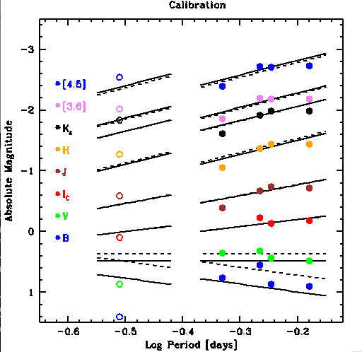
LMC cluster: Reticulum
Test case: Spitzer plus FourStar and optical data from Kuehn 2014.
We observed 10 other LMC clusters and 10 Milky Way Clusters and will calibrate the metallicity dependence on the slope and zeropoint of the PL relations.
Distance modulus = 18.46 placing it on the near side of the LMC (based on theoretical zeropoints)
Need to compare to 5 RRL with HST parallaxes to set empirical distance scale.

Slide 10
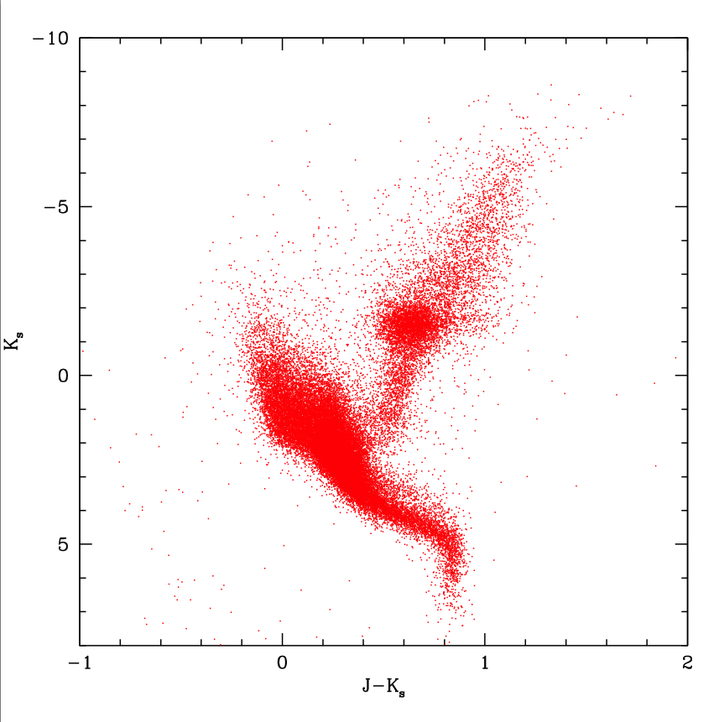
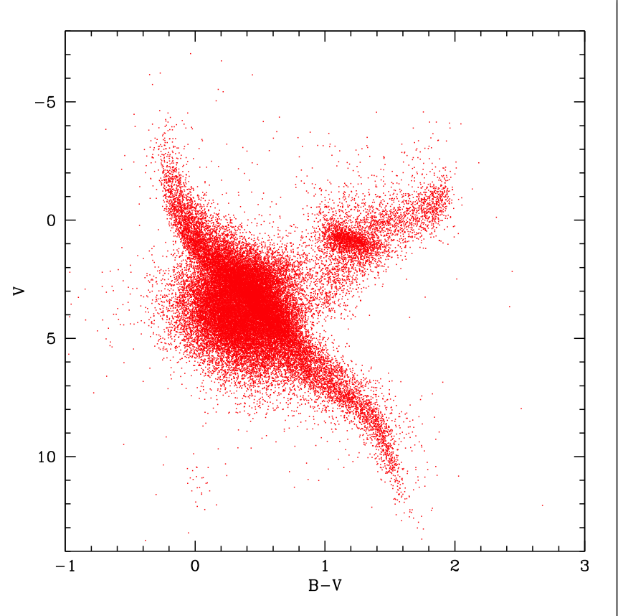
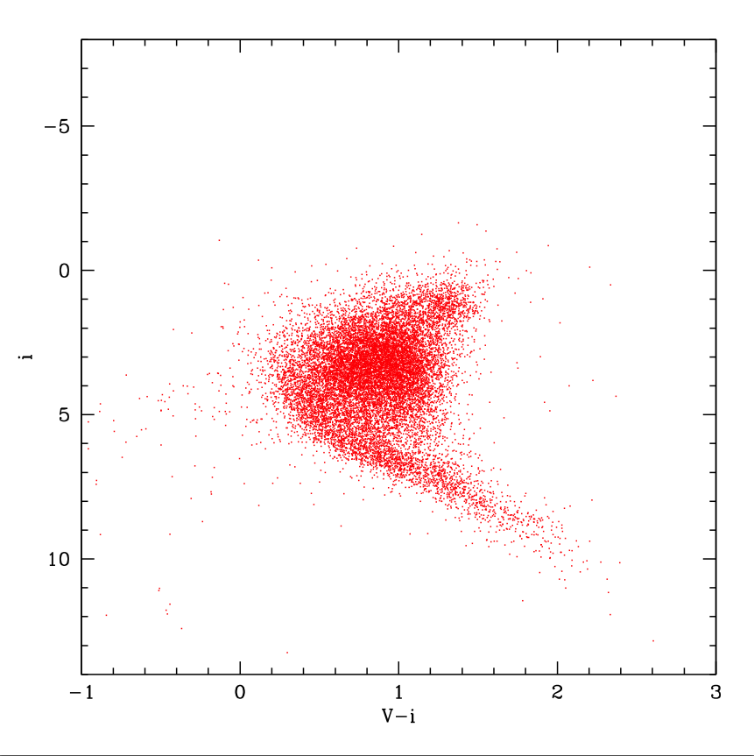
Hipparcos and the local volume TRGB
Hipparcos not quite good enough and there are not many high quality optical (VI) observations of RRL or TRGB stars in the 7-12 mag range. Let’s observe them with a small 12-inch telescope!
Hipparcos barely got enough stars near TRGB in local volume. 2MASS has good measurements and less affected by reddening. Tabur 2009: Mk=-6.85
Hipparcos magnitudes are non-standard and affected by reddening. Would really like to get I-band since that is the standard TRGB metric.
TRGB stars in the local volume are too bright for all sky surveys like APASS or ASAS.

Slide 11
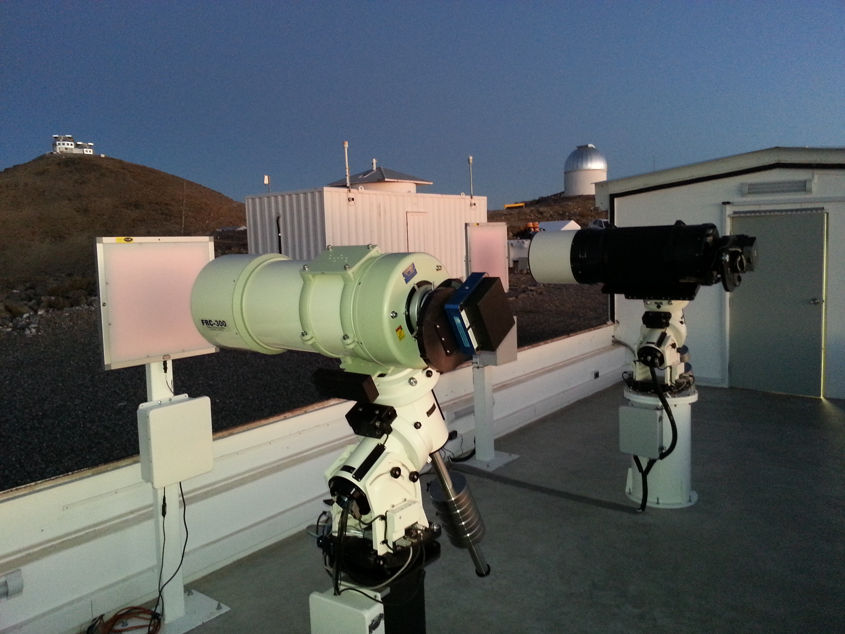
The Three-Hundred mm Telescope (TMMT)
SPECS:
0.3-meter f/7.9 Ritchey-Cretien with a 2048²
e2V CCD Imager (40-arcminute FOV ).
UBVRI+H-alpha filters.
Assembled and tested at SBS and currently deployed at LCO (located behind HAT network telescopes).
Current Programs:
Automated RR Lyrae and TRGB observations.
Deep imaging of extended structure around nearby galaxies.

Slide 12
LCO First Light NGC 2070

Slide 13
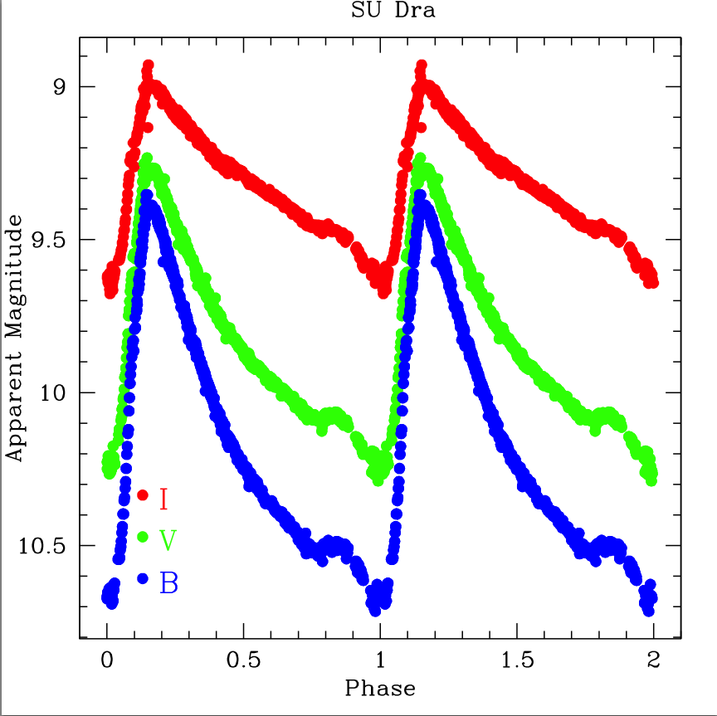
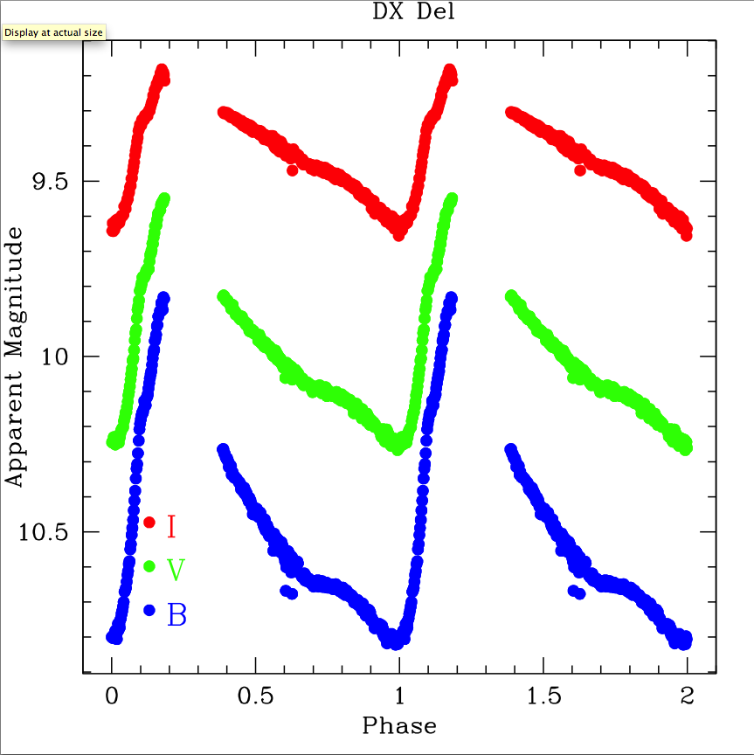
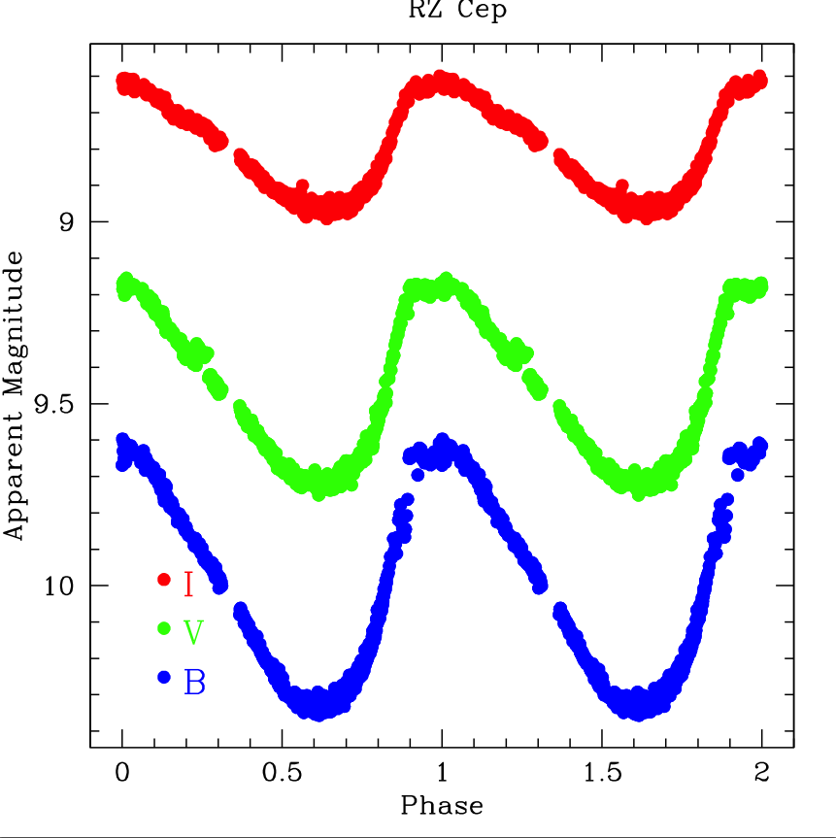
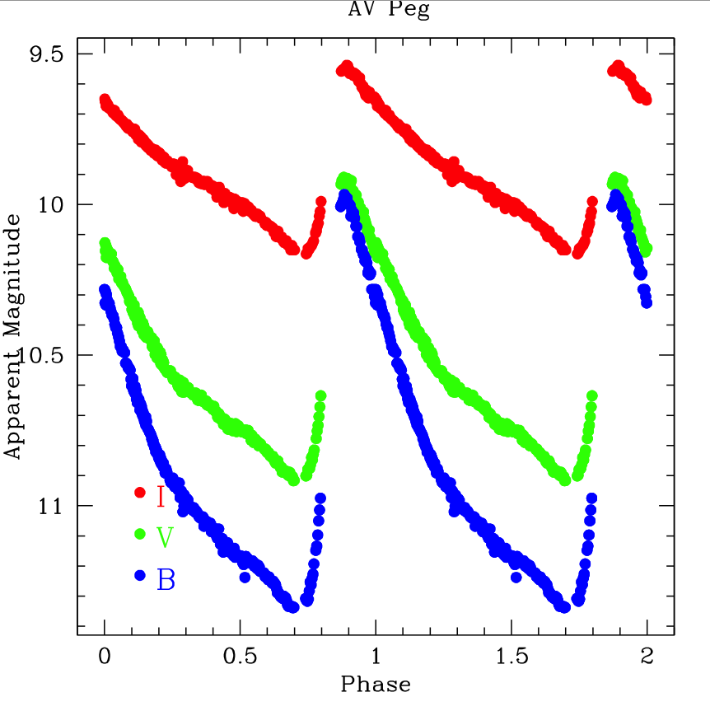
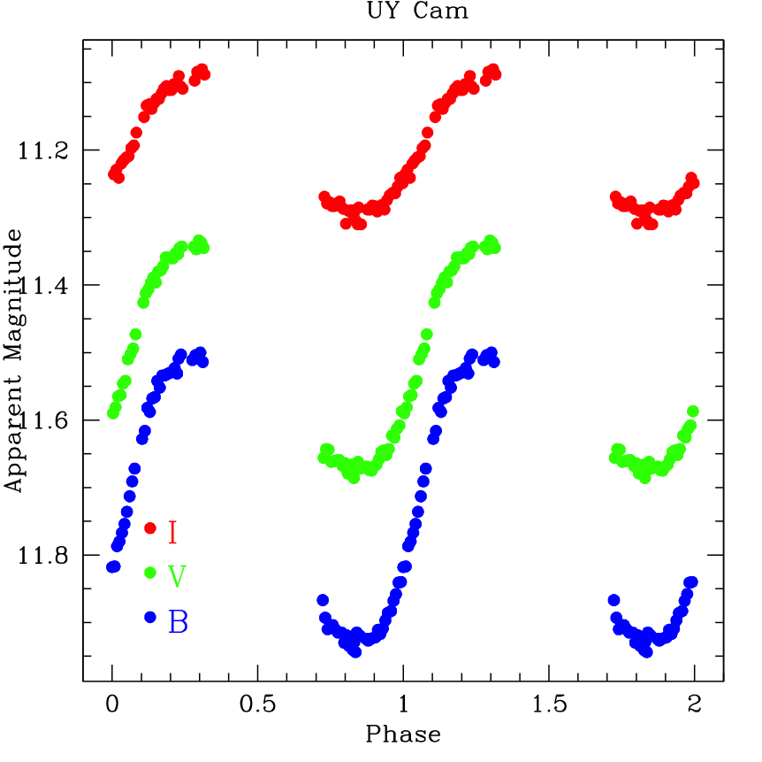
TMMT RR Lyrae Light Curves 33,273 BVI observations for 65 RRL

Slide 14
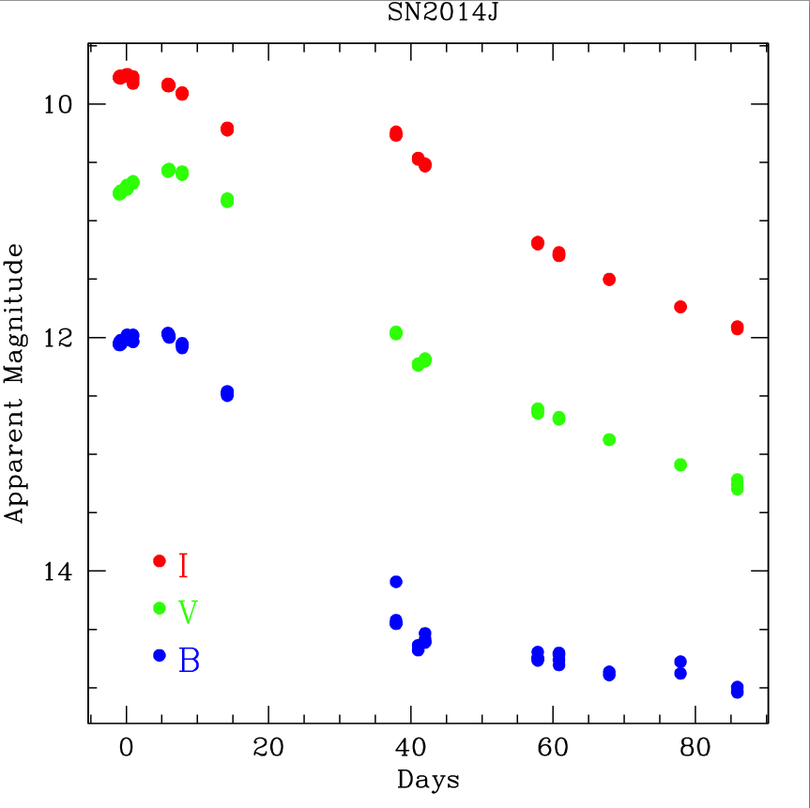
SN2014J

Slide 15
NGC 289

Slide 16
NGC 1566

Slide 17
NGC 6822

Slide 18
NGC 300

Slide 19
Wrapping Up
Still characterizing TMMT performance for DEEP imaging.
Ongoing automated observations of RR Lyrae. TMMT is available for other programs, contact Barry with ideas.
Still a lot of FourStar reductions and photometry of RR Lyraes.
I am available for FourStar support.

